Slide 1
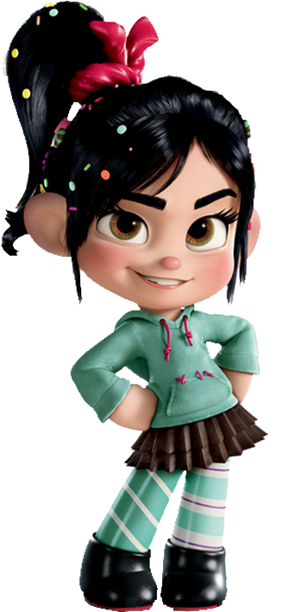
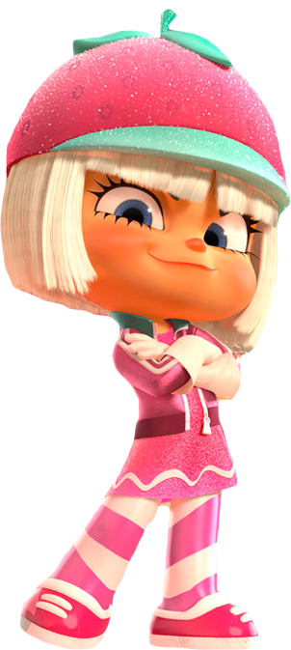
Pictionary
Race
Game Template by Kamohelo Semela

Slide 2
Racer Guide
Divide into two teams – Vanellope /Taffyta
One person from each team comes to the front and takes a card. Don’t show your team the card !!
You have 30 seconds to draw a picture of what’s on the card and your team needs to guess the word/phrase within the given time.
If your team guesses correctly within the given time then you advance on the race track
If both teams guess correctly then each person playing rolls a die and the biggest number gets to advance on the race track.

Slide 3
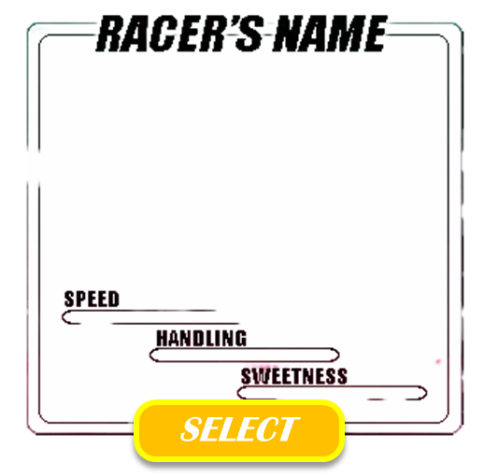
Vanellope von schweetz
Taffyta muttonfudge !!
PLAY RPS, THE WINNER CHOOSES A RACER

Slide 4
3
2
1

Slide 5
Winner
Vanellope von schweetz!!
Winner
Taffyta mutton fudge !!
finish
START

Slide 6
Insert text
Insert text
Insert text
Insert text
Insert text
Insert text
Insert text
Insert text

Slide 8
Insert text
Insert text
Insert text
Insert text
Insert text
Insert text
Insert text
Insert text

Slide 10
Insert text
Insert text
Insert text
Insert text
Insert text
Insert text
Insert text
Insert text

Slide 12
Insert text
Insert text
Insert text
Insert text
Insert text
Insert text
Insert text
Insert text

