Slide 1
ESL EDITION
Game Template by Kamohelo Semela

Slide 2
HOW TO PLAY
Make two teams
Red team
Green team

Slide 3
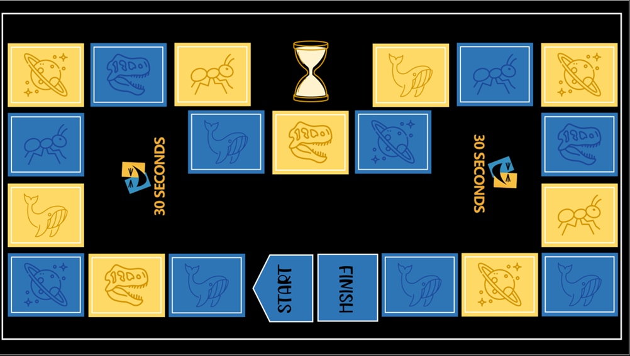
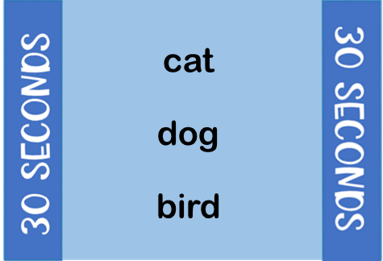
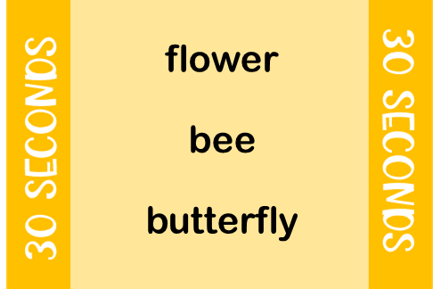
HOW TO PLAY
Each round one person from one of the teams will pick a card. If your game piece is on a yellow square then pick a yellow card, if it’s on a blue square pick a blue card.

Slide 4
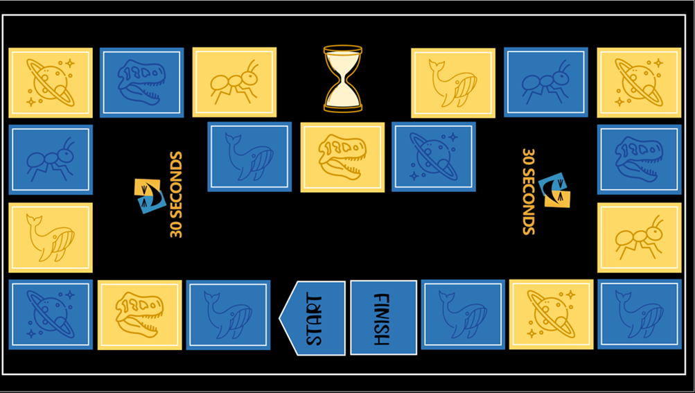
HOW TO PLAY
Try to describe everything on the card to your team without saying the words on the card! The number of words your team guesses correctly within 30 seconds = the number of times you can move on the board !
It meows !
?
cat!

Slide 5
Ready ?

Slide 8
Text here
Text here
Text here
Text here
Text here
Text here
Text here
Text here
Text here
Text here
Text here
Text here
Text here
Text here
Text here
Text here
Text here
Text here
Text here
Text here
Text here
Text here
Text here
Text here
Text here
Text here
Text here
Text here
Text here
Text here
Text here
Text here
Text here
Text here
Text here
Text here

Slide 10
Text here
Text here
Text here
Text here
Text here
Text here
Text here
Text here
Text here
Text here
Text here
Text here
Text here
Text here
Text here
Text here
Text here
Text here
Text here
Text here
Text here
Text here
Text here
Text here
Text here
Text here
Text here
Text here
Text here
Text here
Text here
Text here
Text here
Text here
Text here
Text here

