Slide 1
?
?
?
Dory’s memory finder
Notes:
Hi ! The idea behind this game is that, by answering the questions, students essentially help Dory remember. I left it this simple so that anyone can tailor it to their own lesson. Have fun.

Slide 2
instructions
Each round students pick a number.
The number will lead you to a question slide.
If you answer correctly you get a reward.

Slide 3
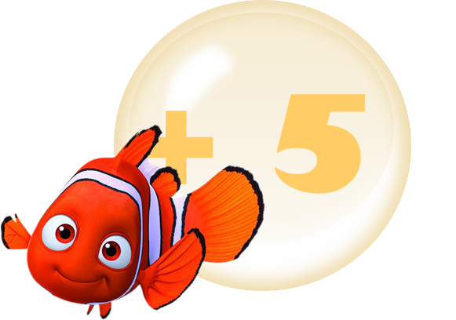
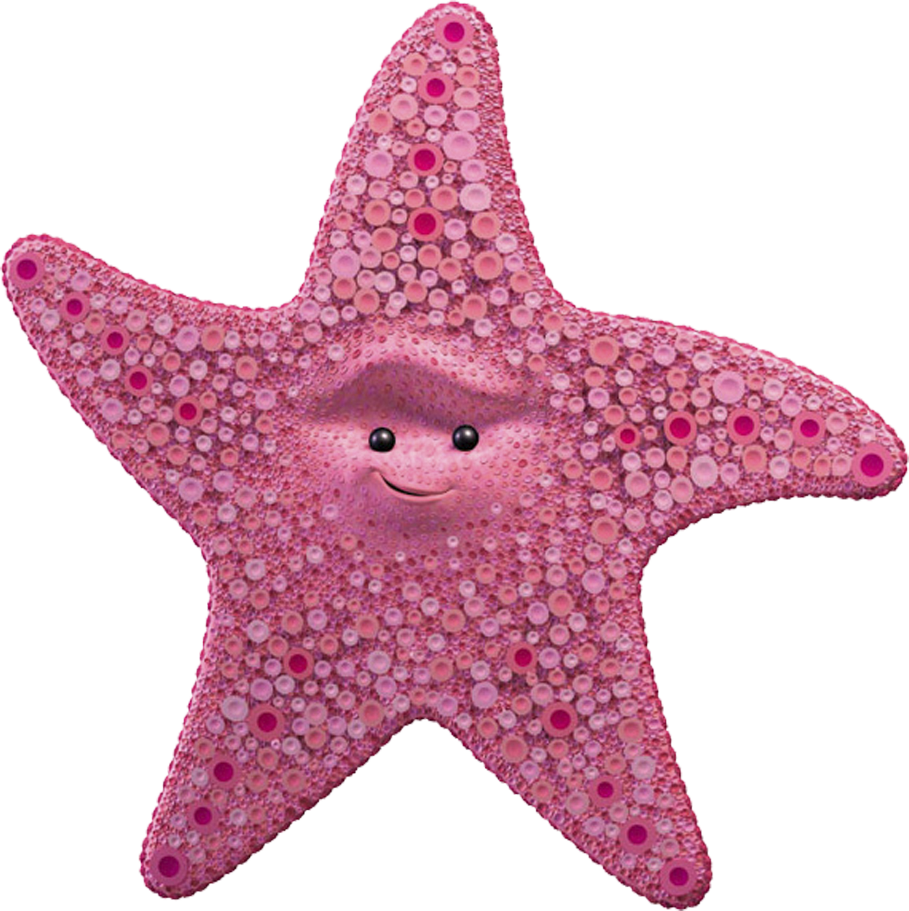
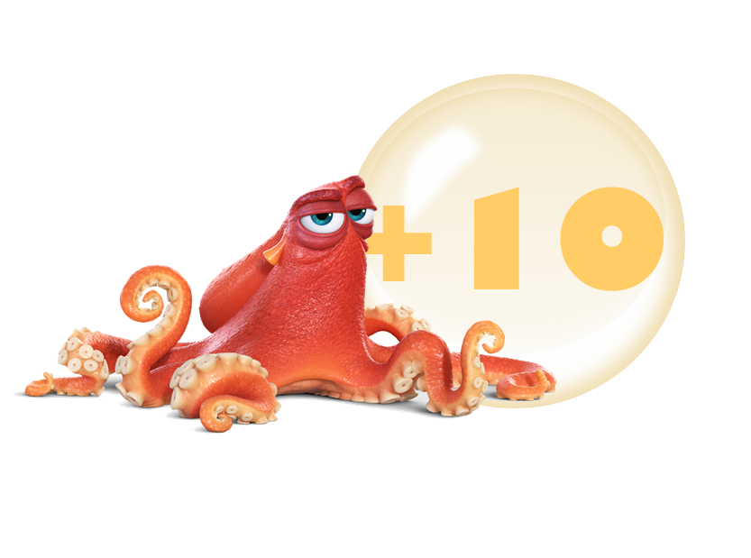
rewards
= 1
= 2
= 3

Slide 4
1
2
3
4
5
6
7
8
9
10
11
12
13
14
15
16
17
18
19
20

Slide 5
Question goes here
Additional text and/or images
Answer goes here
Notes:
Click the yellow rounded edge rectangle to make the answer appear. Happy Dory takes you to a reward slide and confused Dory takes you to the question choosing slide.

Slide 6
Notes:
Dory in the bubble takes you back to the question choosing slide.

Slide 7
Question goes here
Additional text and/or images
Answer goes here

Slide 8
Steal
5

Slide 9
Question goes here
Additional text and/or images
Answer goes here

Slide 10
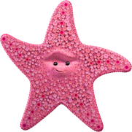

Slide 11
Question goes here
Additional text and/or images
Answer goes here

Slide 13
Question goes here
Additional text and/or images
Answer goes here

Slide 15
Question goes here
Additional text and/or images
Answer goes here

Slide 17
Question goes here
Additional text and/or images
Answer goes here

Slide 19
Question goes here
Additional text and/or images
Answer goes here

Slide 21
Question goes here
Additional text and/or images
Answer goes here

Slide 23
Question goes here
Additional text and/or images
Answer goes here

Slide 25
Question goes here
Additional text and/or images
Answer goes here

Slide 26
Steal
5

Slide 27
Question goes here
Additional text and/or images
Answer goes here

Slide 28
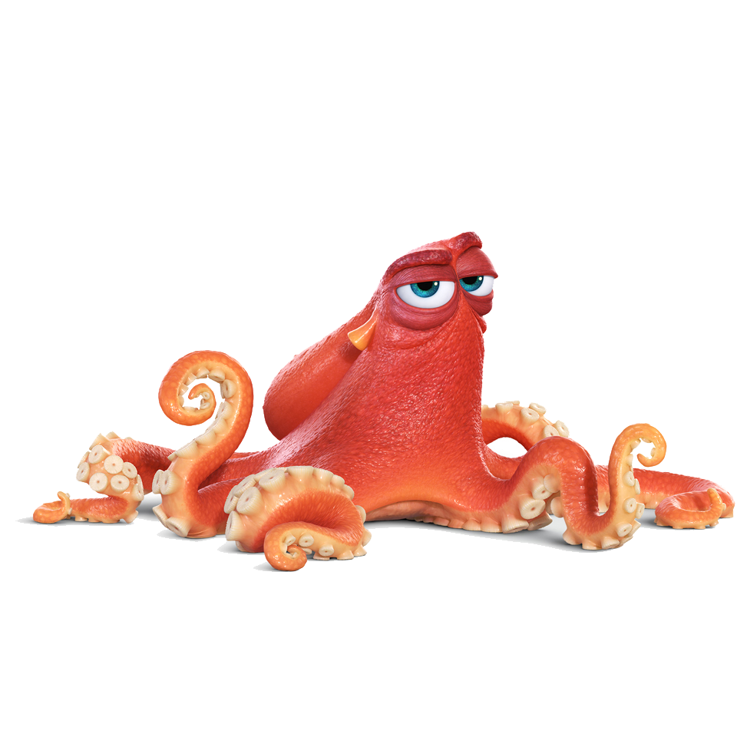
+10

Slide 29
Question goes here
Additional text and/or images
Answer goes here

Slide 31
Question goes here
Additional text and/or images
Answer goes here

Slide 33
Question goes here
Additional text and/or images
Answer goes here

Slide 35
Question goes here
Additional text and/or images
Answer goes here

Slide 37
Question goes here
Additional text and/or images
Answer goes here

Slide 39
Question goes here
Additional text and/or images
Answer goes here

Slide 40
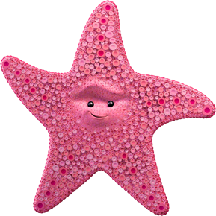

Slide 41
Question goes here
Additional text and/or images
Answer goes here

Slide 43
Question goes here
Additional text and/or images
Answer goes here

Slide 44
+10

Slide 45
+ 5
Steal
5
+10

