Slide 1
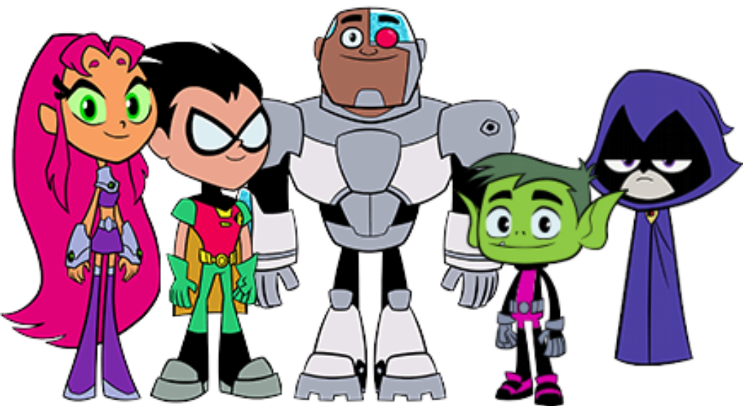
Game template by Kamohelo T. Semela
UNSCRAMBLE

Slide 2
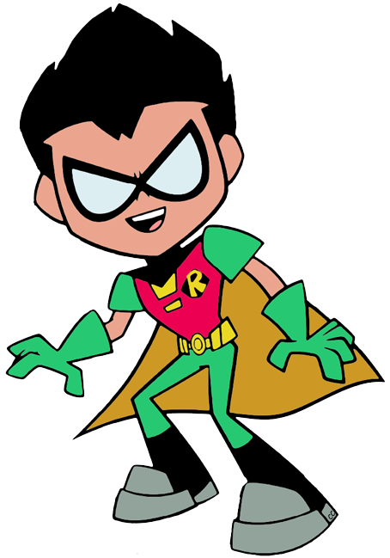
Unscramble the words and sentences to help us understand her !
Help! Starfire can’t speak properly

Slide 3
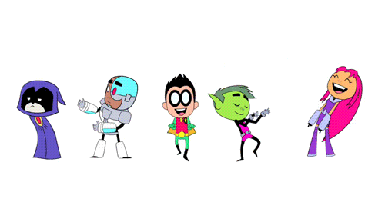
practice
Round

Slide 4
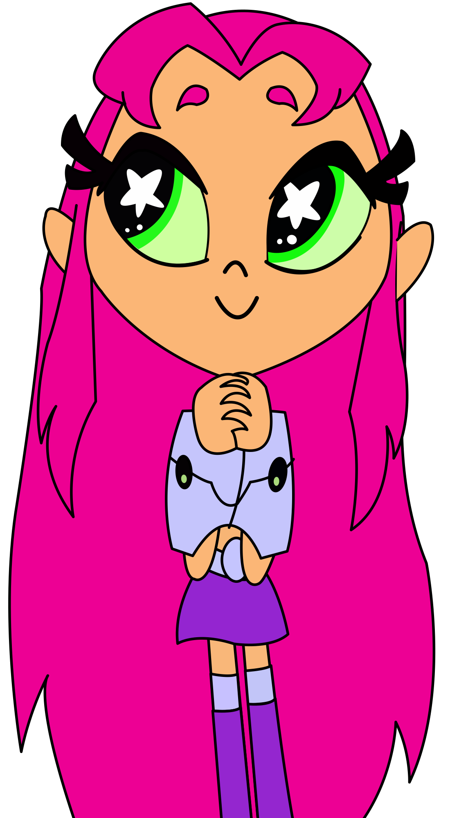
Capmnig

Slide 5
Camping

Slide 6
2 pts
Round 1

Slide 7
s
Scrambled word

Slide 8
Correct word

Slide 9
Scrambled word

Slide 10
Correct word

Slide 11
Scrambled word

Slide 12
Correct word

Slide 13
3 pts
Round 2

Slide 14
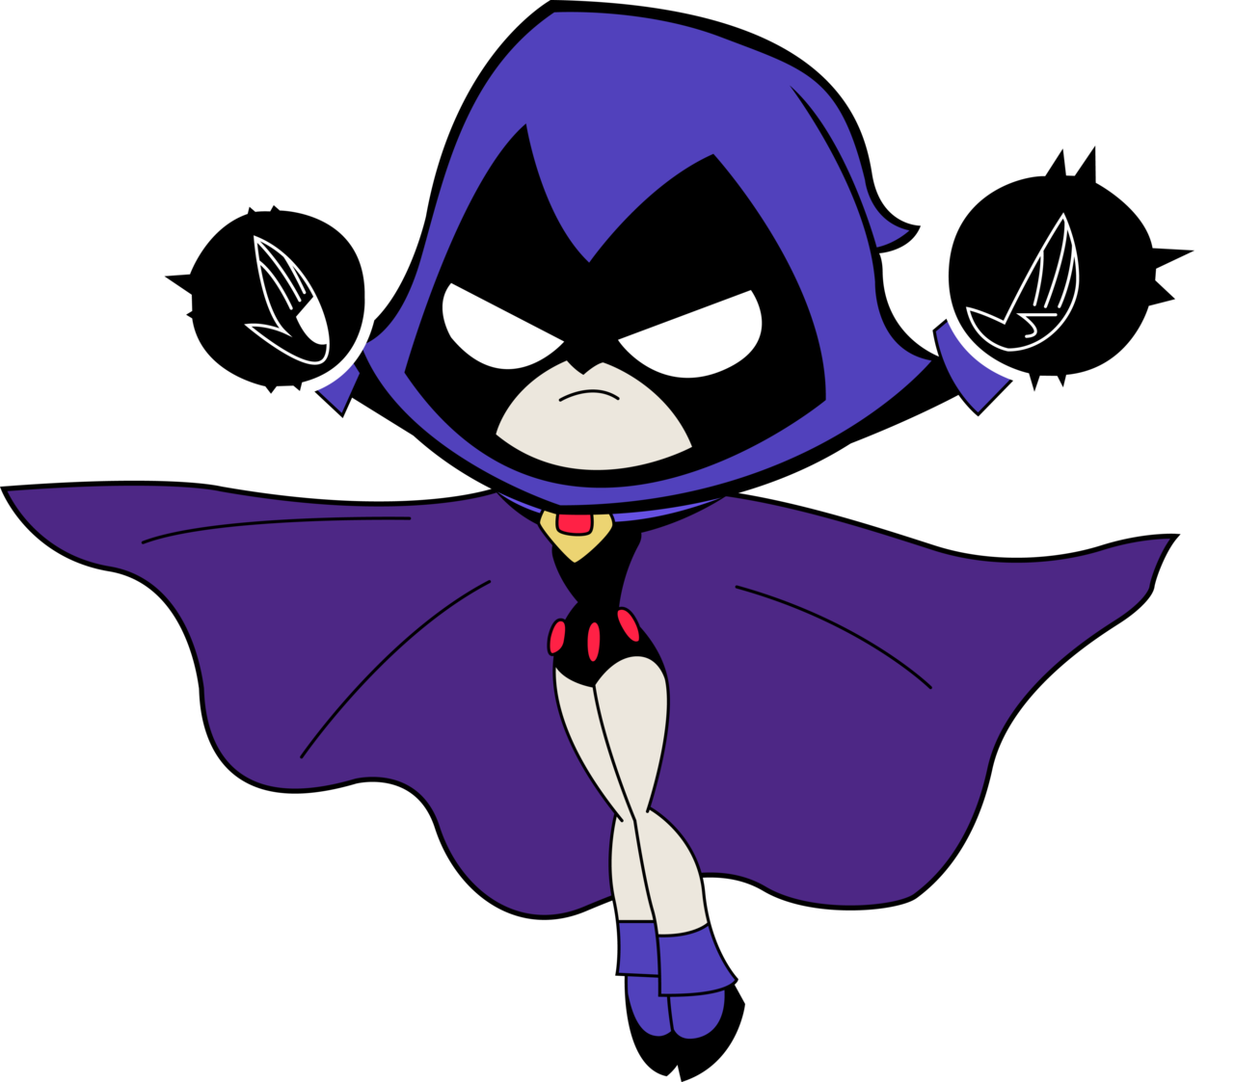
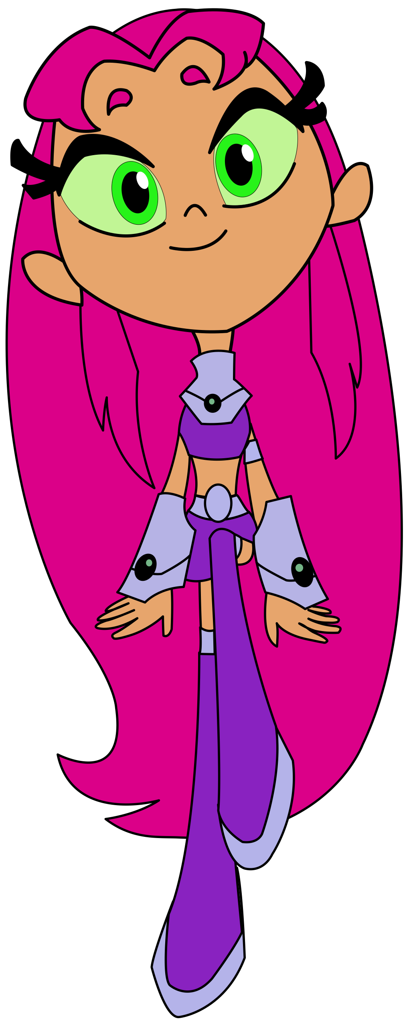
Target question here
Scrambled sentence
Notes:
If there’s no target question just go on ahead and delete that text, I usually keep the characters because students get excited to see them.

Slide 15
Target question here
Correct sentence

Slide 16
Target question here
Scrambled sentence

Slide 17
Target question here
Correct sentence

Slide 18
Target question here
Scrambled sentence

Slide 19
Target question here
Correct sentence

Slide 20
5 pts
Round 3

Slide 21
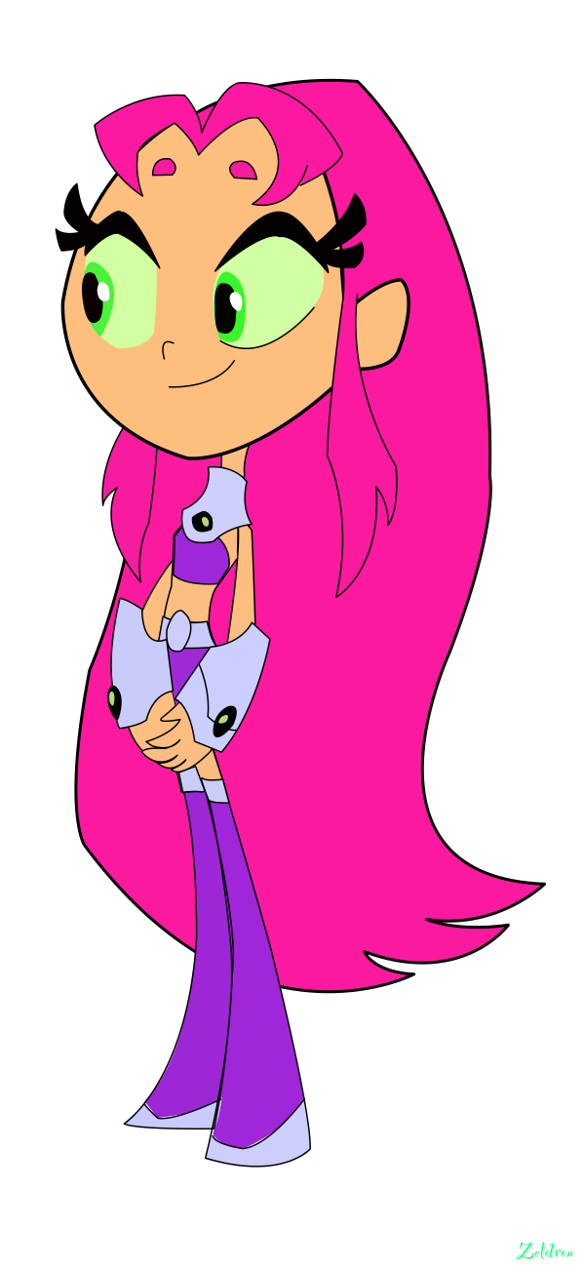
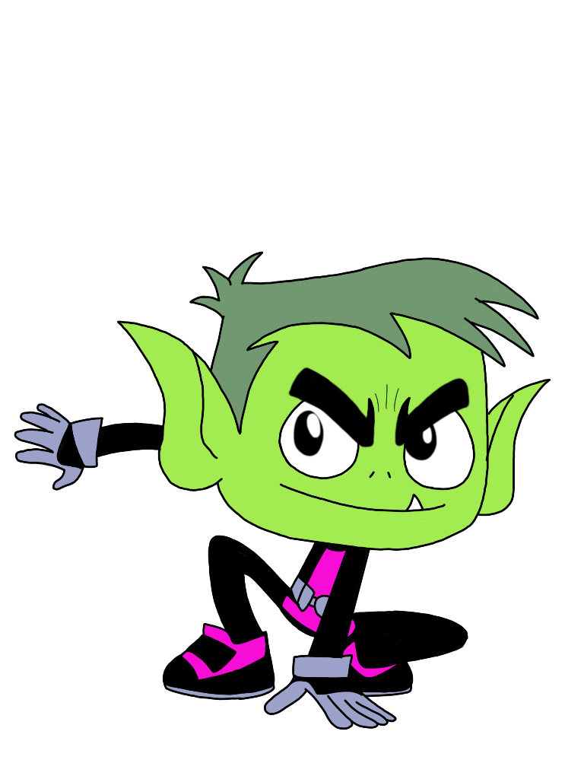
Scrambled sentence here
Target question here

Slide 22
Target question here
Correct sentence

Slide 23
Scrambled sentence here
Target question here

Slide 24
Target sentence here
Correct sentence

Slide 25
Scrambled sentence
Target question here

Slide 26
Target question here
Correct sentence

Slide 27
10 pts
Round 4

Slide 28
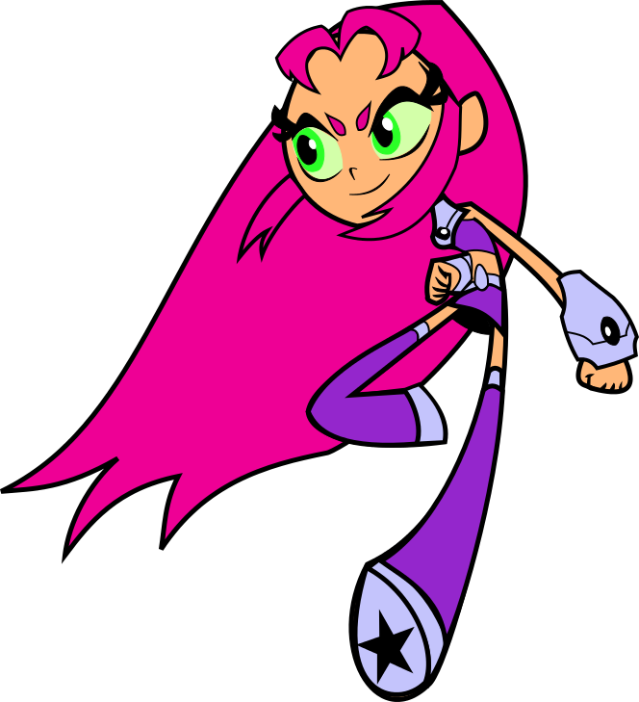
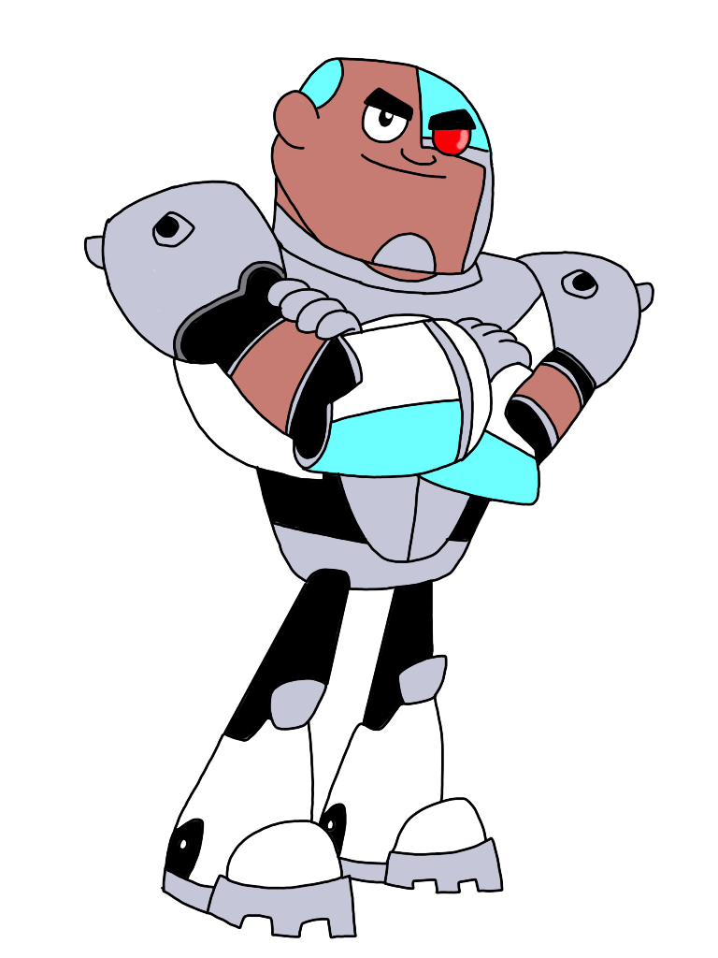
Scrambled sentence here
Target question here

Slide 29
Target question here
Correct sentence here

Slide 30
Scrambled sentence here
Target question here

Slide 31
Target question here
Correct sentence here

Slide 32
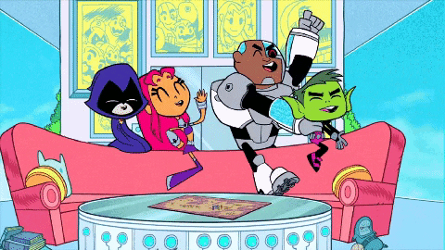
GAME OVER

