Slide 1
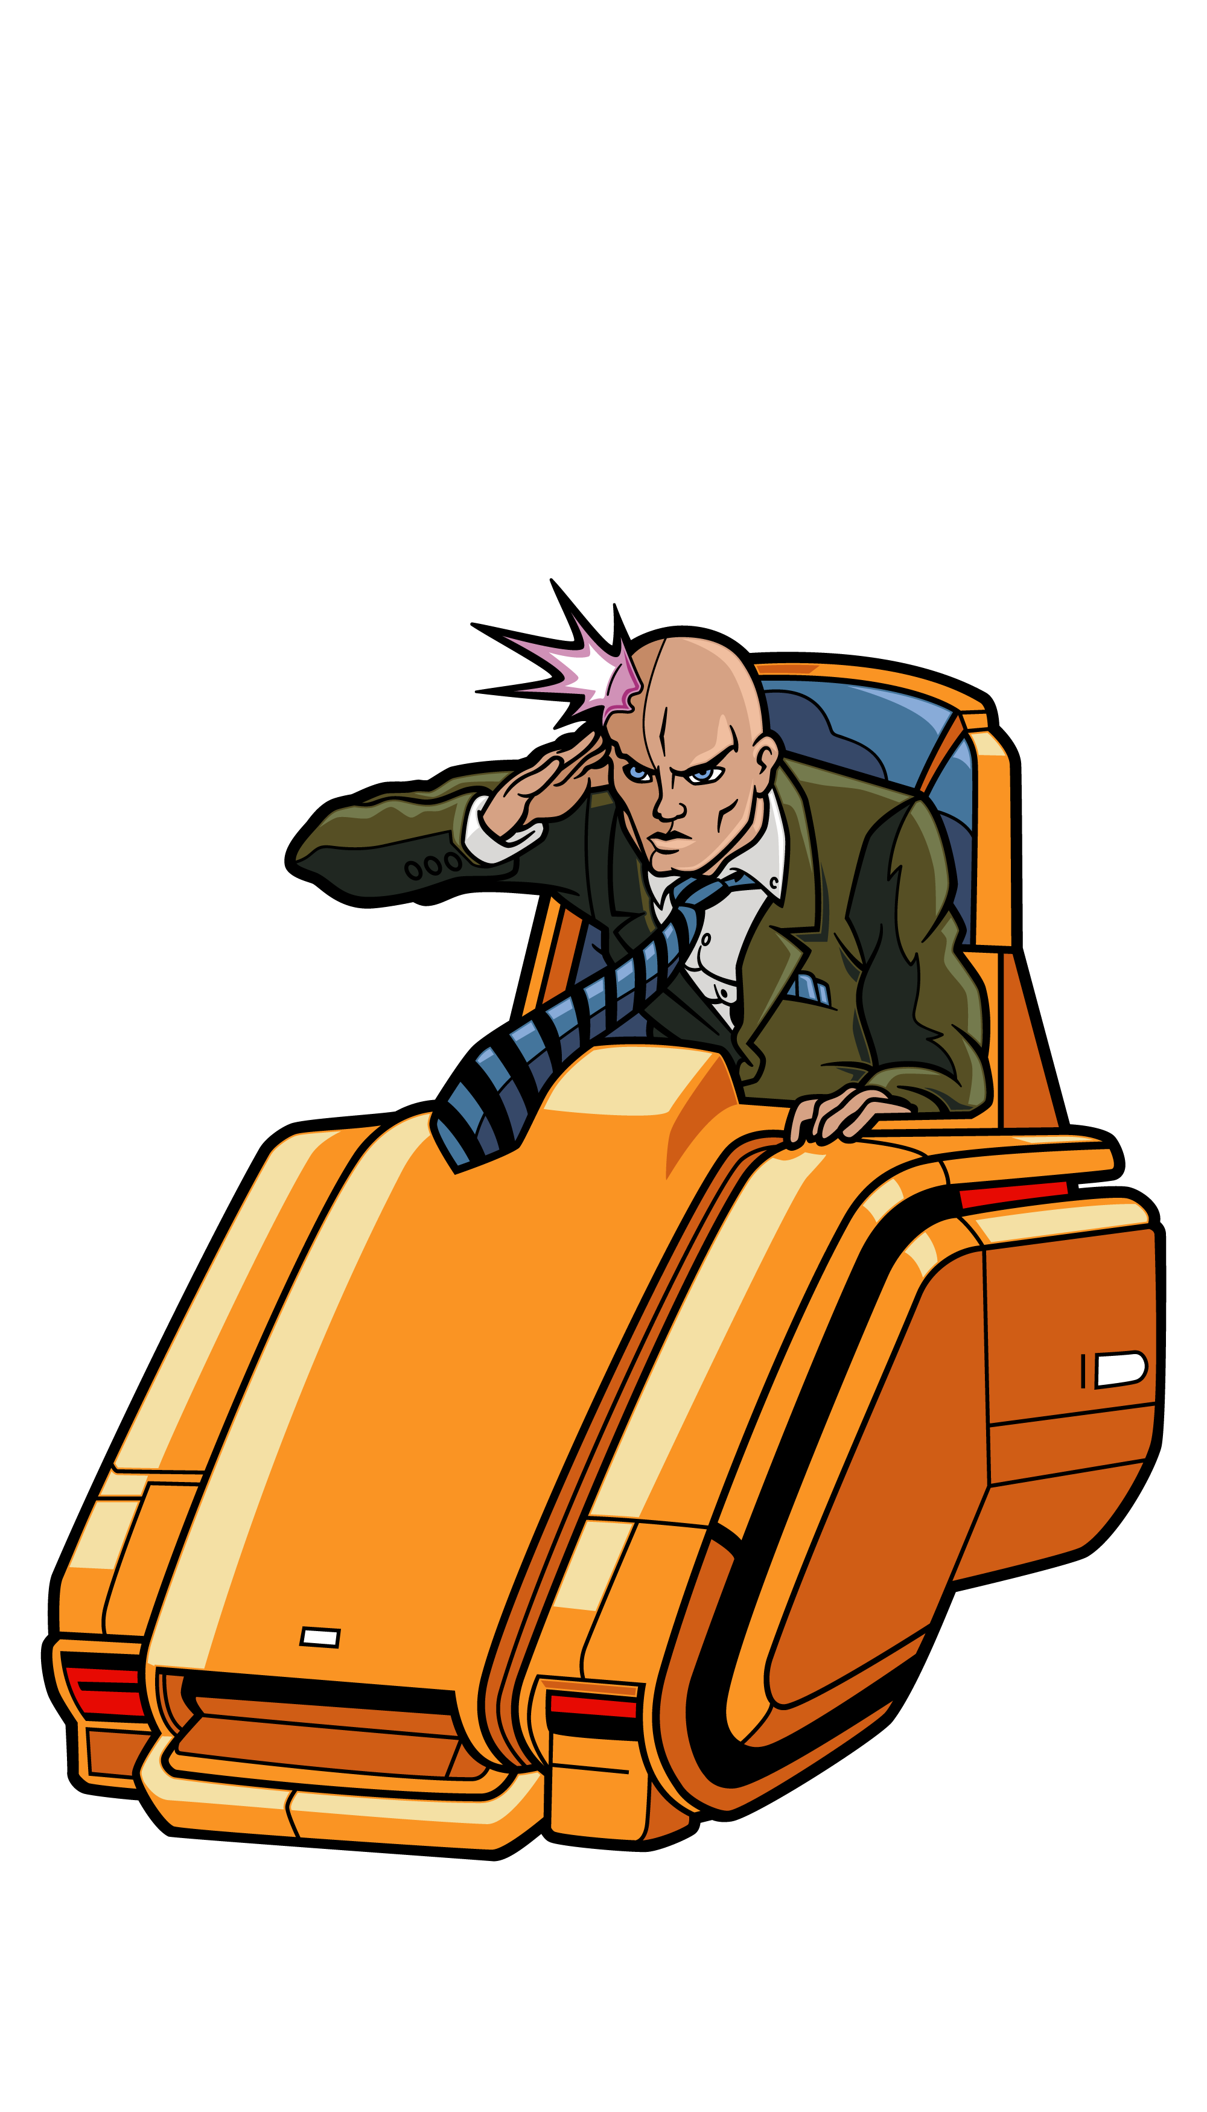
Telepathy
Start

Slide 2
How to play
Split into teams.
Each team gets a whiteboard, marker and an eraser/wipe.
Each round, three characters will appear.
Use telepathy to figure out which character Professor X is communicating with.
To choose a character, write the sentence next to them on your whiteboard.
If you guess correctly the team gets 5 points.

Slide 3
Type sentence/word here
Type sentence/word here
Type sentence/word here

Slide 4
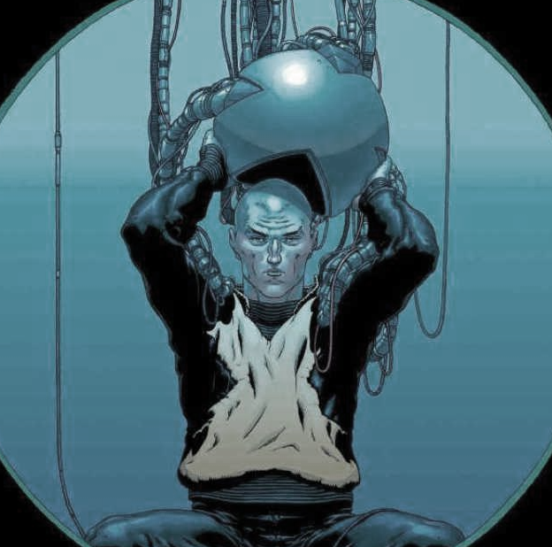
Type sentence/word here

Slide 5
Type sentence/word here
Type sentence/word here
Type sentence/word here

Slide 6
Type sentence/word here

Slide 7
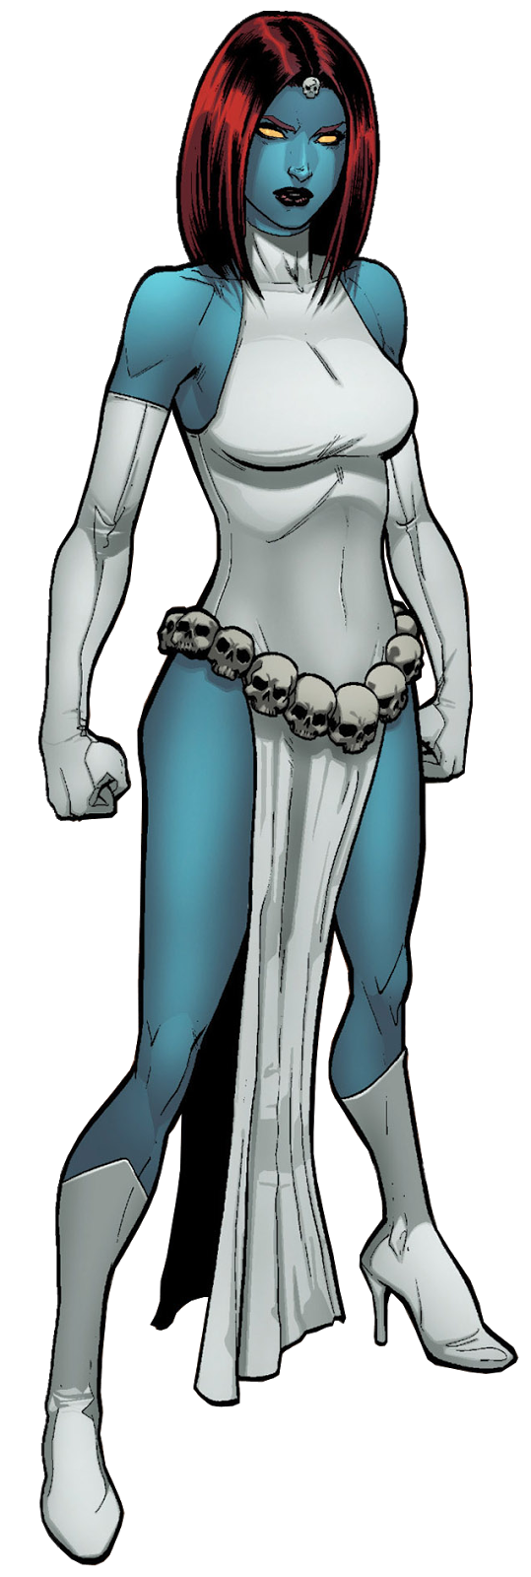
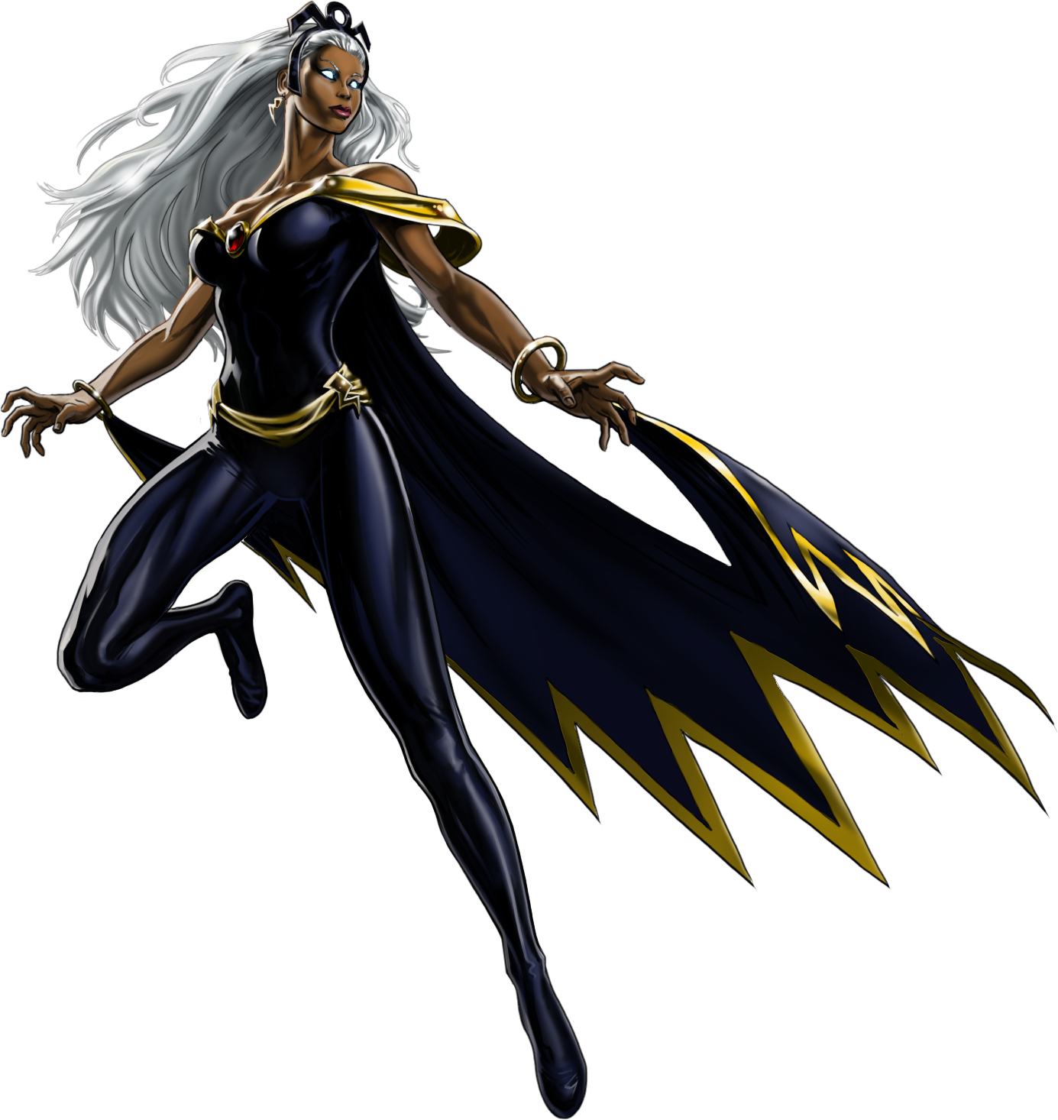
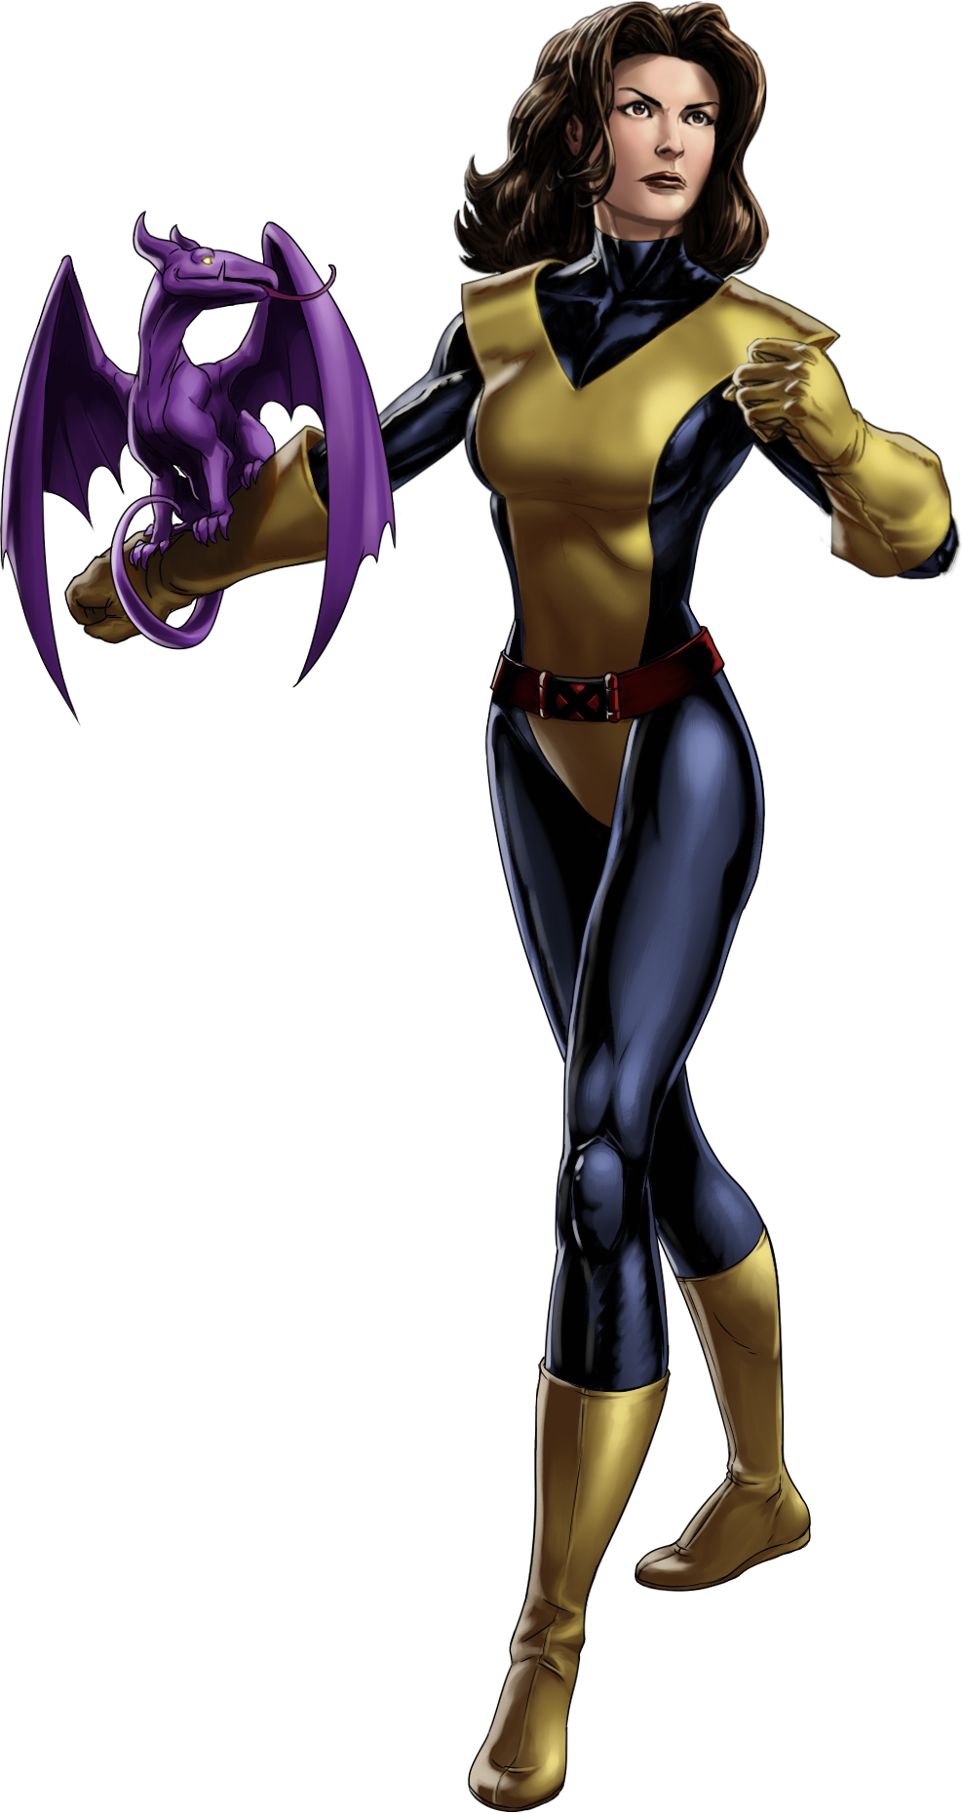
Type sentence/word here
Type sentence/word here
Type sentence/word here

Slide 8
Type sentence/word here

Slide 9
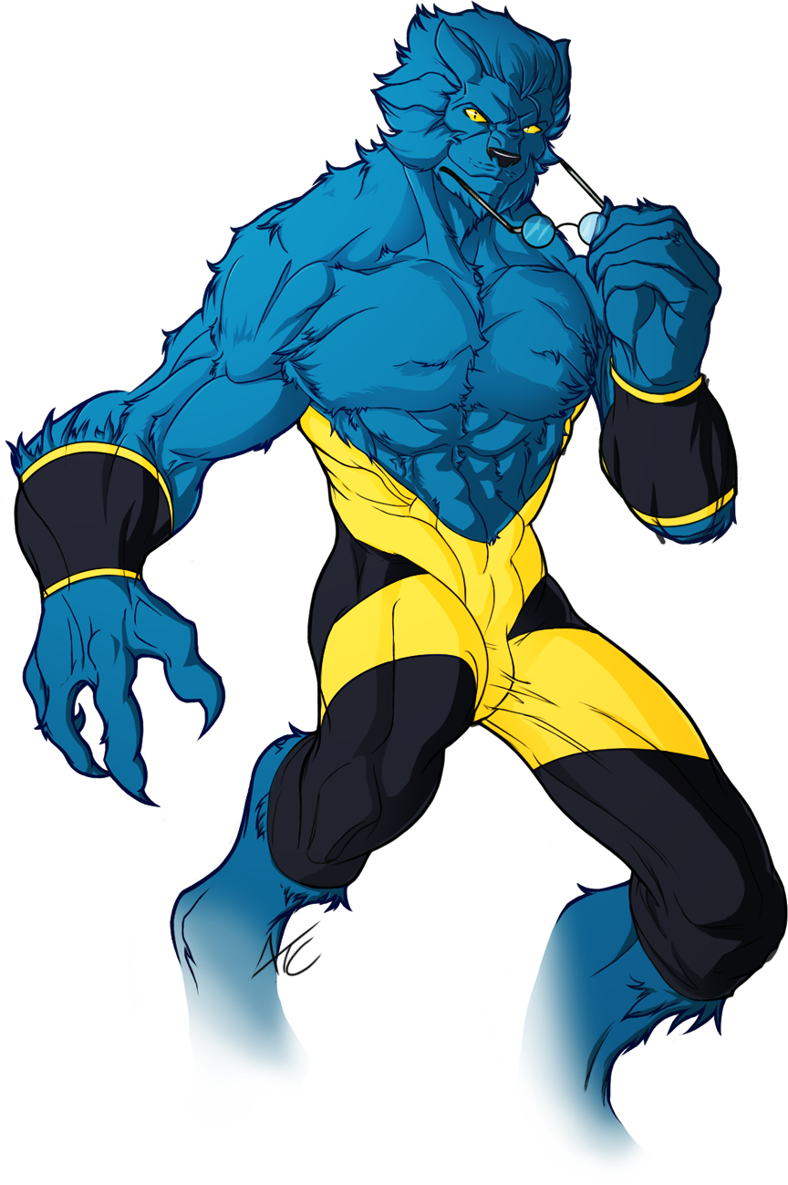
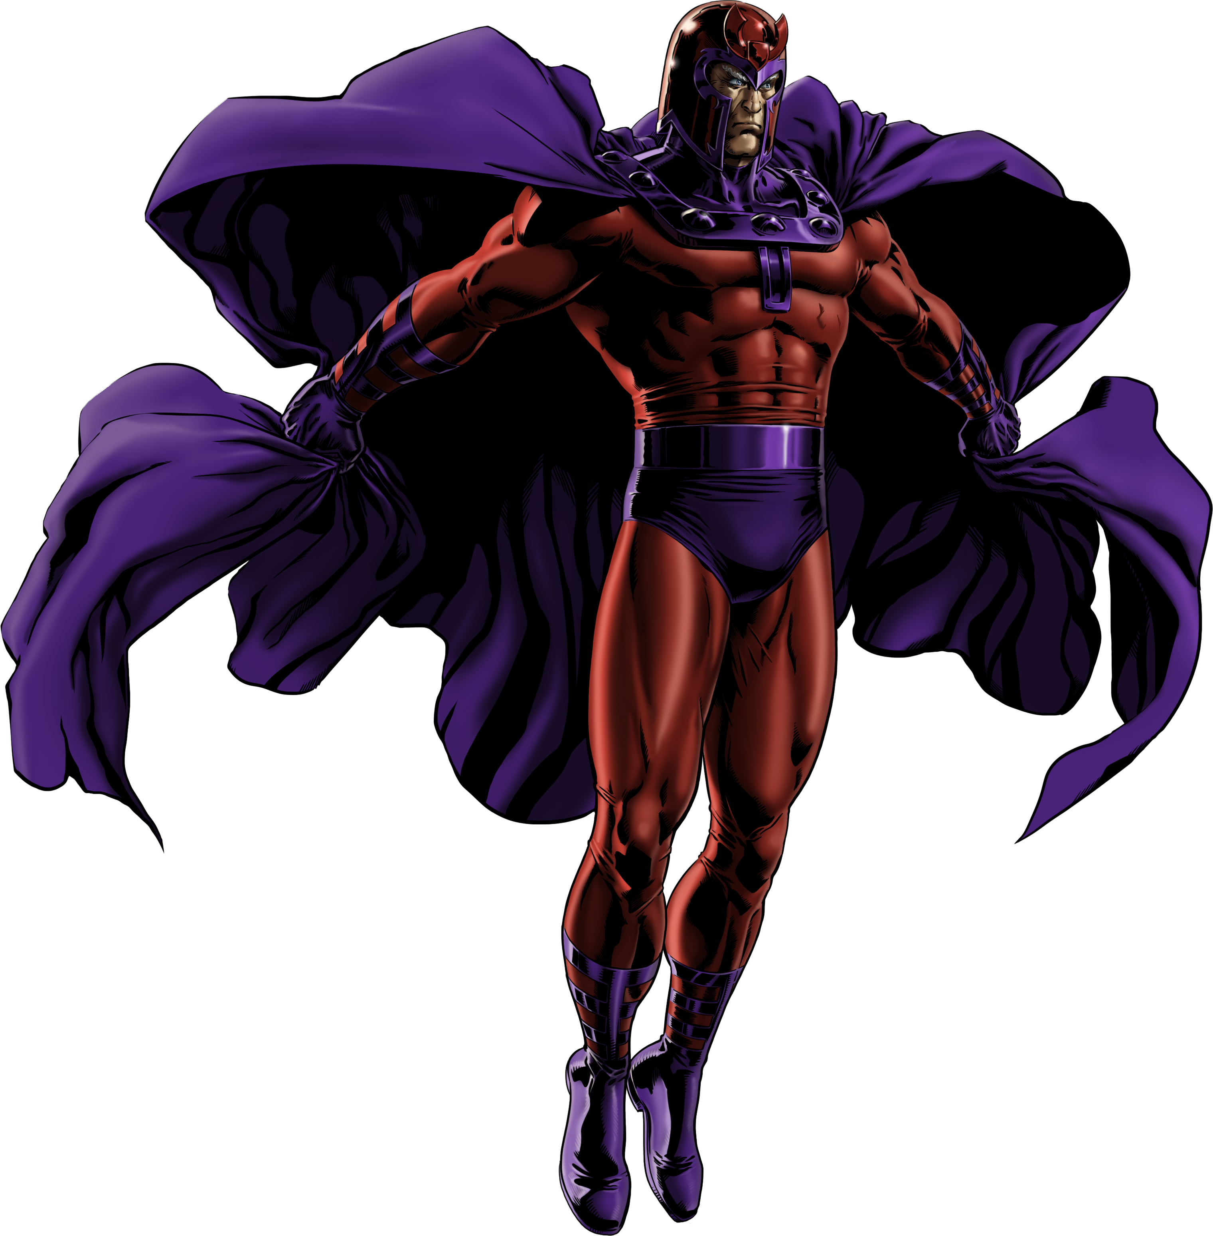
Type sentence/word here
Type sentence/word here
Type sentence/word here

Slide 10
Type sentence/word here

Slide 11
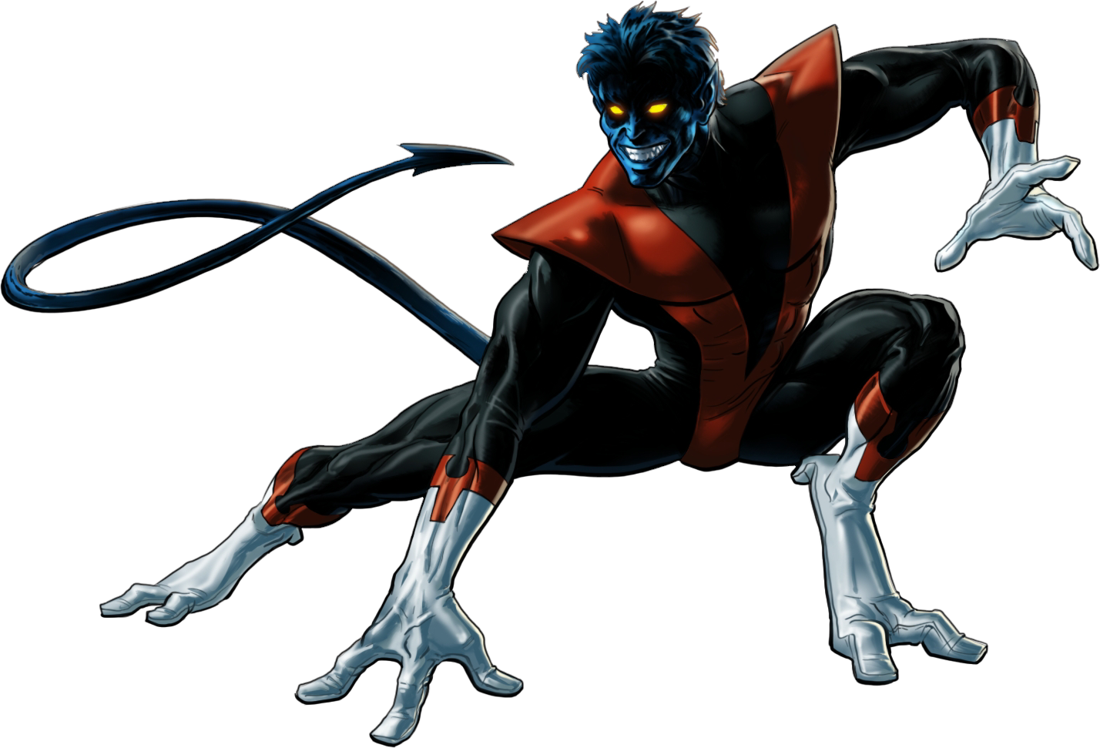
Type sentence/word here
Type sentence/word here
Type sentence/word here

Slide 12
Type sentence/word here

Slide 13
Type sentence/word here
Type sentence/word here
Type sentence/word here

Slide 14
Type sentence/word here

Slide 15
Type sentence/word here
Type sentence/word here
Type sentence/word here

Slide 16
Type sentence/word here

Slide 17
Type sentence/word here
Type sentence/word here
Type sentence/word here

Slide 18
Type sentence/word here

Slide 19
Type sentence/word here
Type sentence/word here
Type sentence/word here

Slide 20
Type sentence/word here

Slide 21
Type sentence/word here
Type sentence/word here
Type sentence/word here

Slide 22
Type sentence/word here

Slide 23
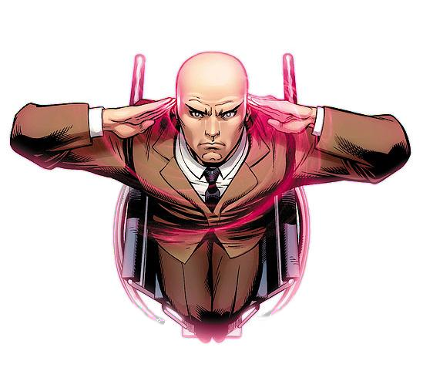
GAME
OVER

