Slide 1
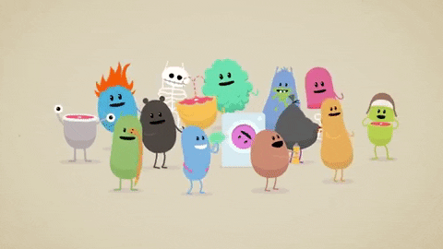
Jelly
Bean
Matching
start

Slide 2
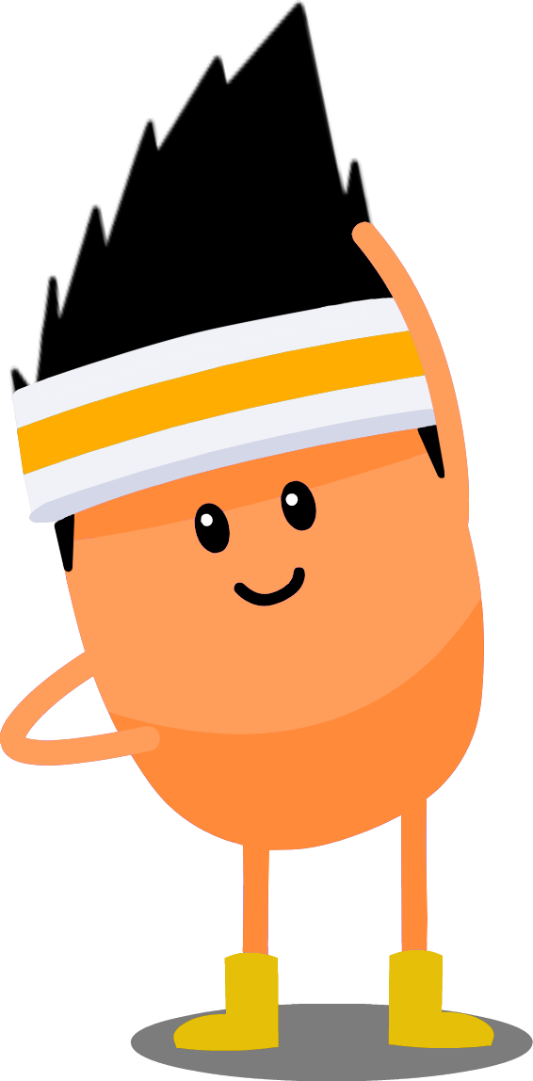
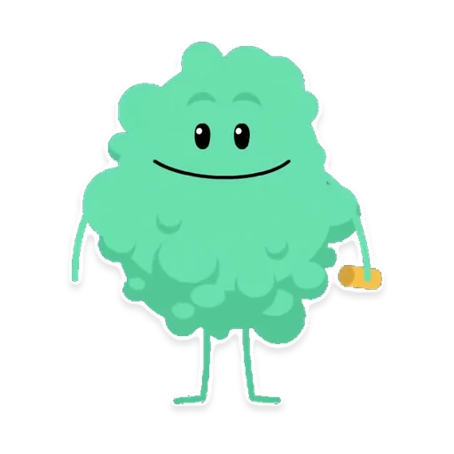
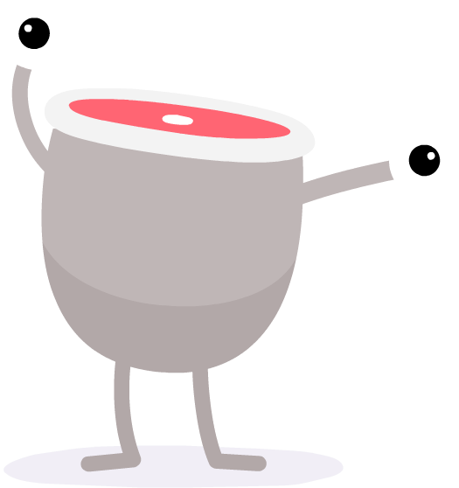
How to play
Divide the class into teams
each round one team reads two sentences
the teacher will then click on the sentences to reveal the injured jellybeans. If the jellybeans match then the team gets two points.
the team with the highest score at the end wins the game.

Slide 3
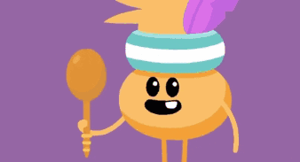
Round One

Slide 4
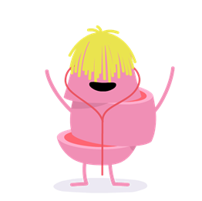
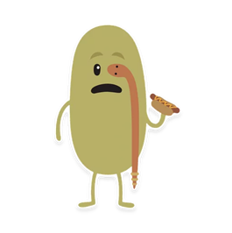
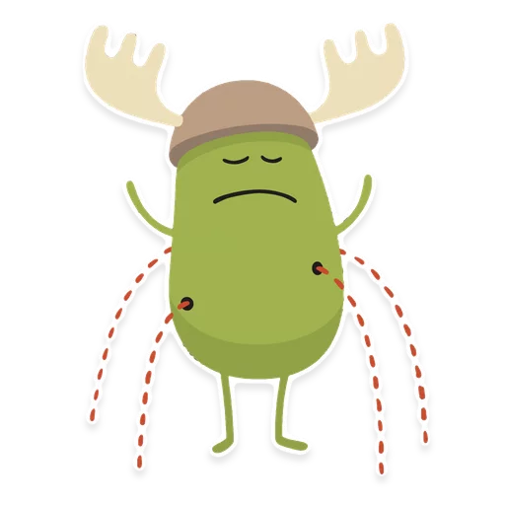
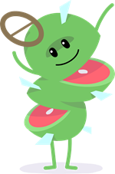
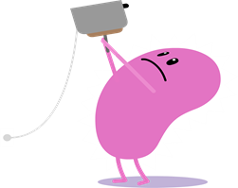
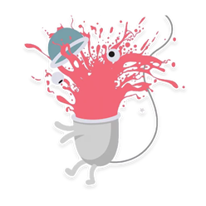
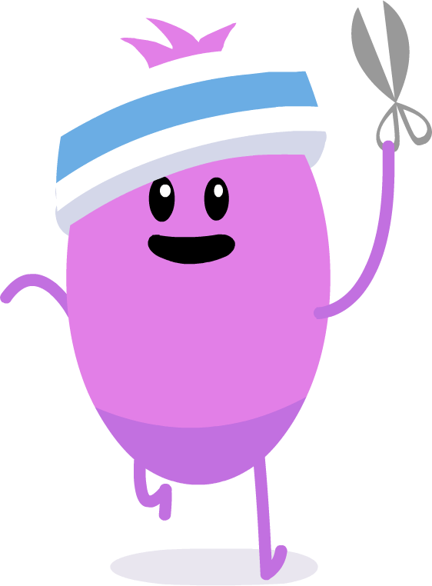
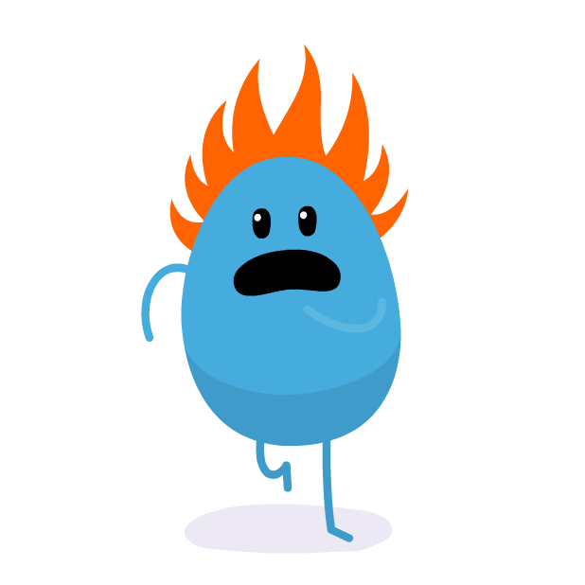
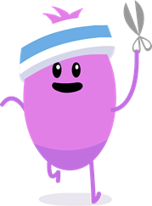
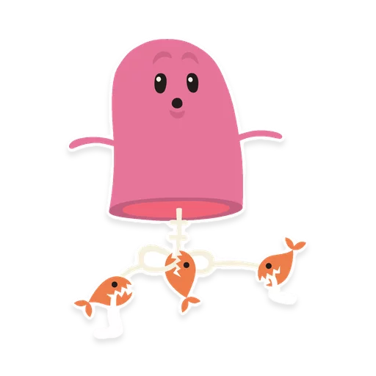
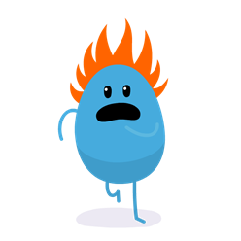
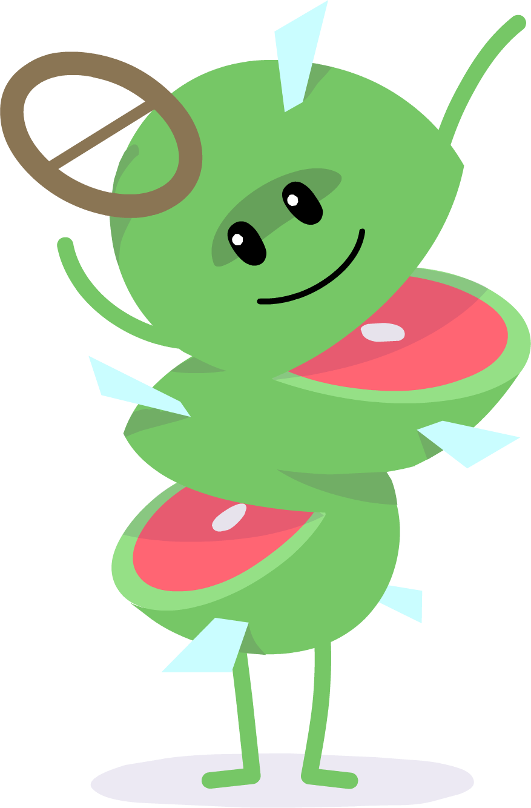
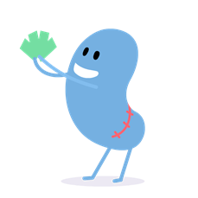
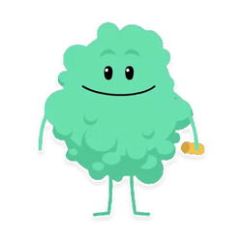
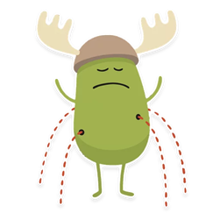
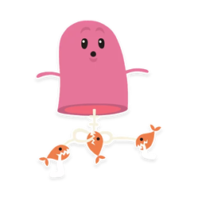
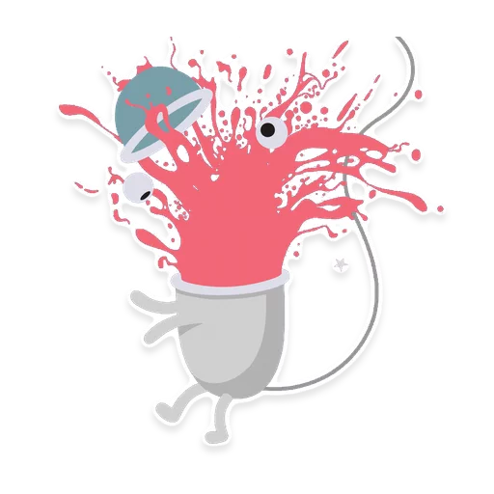
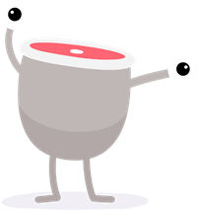
Insert text
Insert text
Insert text
Insert text
Insert text
Insert text
Insert text
Insert text
Insert text
Insert text
Insert text
Insert text
Insert text
Insert text
Insert text
Insert text
Insert text
Insert text
Insert text
Insert text
Insert text
Insert text
Insert text
Insert text
Insert text
Insert text
Insert text
Insert text
Insert text
Insert text
Insert text
Insert text
Insert text
Insert text
Insert text
Insert text
Insert text
Insert text
Insert text
Insert text
Insert text
Insert text
Insert text
Insert text
Insert text
Insert text
Insert text
Insert text

Slide 5
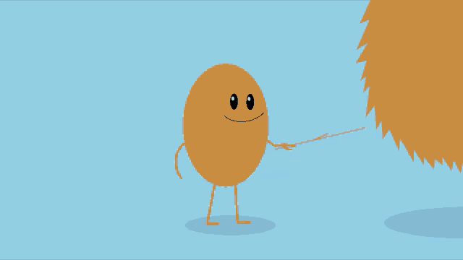
Round Two

Slide 6
Insert text
Insert text
Insert text
Insert text
Insert text
Insert text
Insert text
Insert text
Insert text
Insert text
Insert text
Insert text
Insert text
Insert text
Insert text
Insert text
Insert text
Insert text
Insert text
Insert text
Insert text
Insert text
Insert text
Insert text
Insert text
Insert text
Insert text
Insert text
Insert text
Insert text
Insert text
Insert text
Insert text
Insert text
Insert text
Insert text
Insert text
Insert text
Insert text
Insert text
Insert text
Insert text
Insert text
Insert text
Insert text
Insert text
Insert text
Insert text

Slide 7
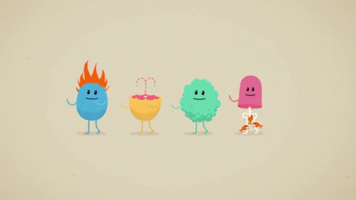
GAME
OVER

