Slide 1
Sentence
Relay

Slide 2
How to play
Split into two teams, red and blue.
Each team stands in a line at the back of the class facing the screen.
Each round, scrambled words will appear on the screen.
The person at the front of the line (for each team) runs to the front and writes down the first word correctly on the board. Then they run back to tap the next person in line’s hand.
Once the next person’s hand is tapped they run to the board and unscramble the next word.
After the last word, the next person has to unscramble the sentence.
The first team to write all the words correctly and unscramble the sentence wins the round and gets to advance on the race track.

Slide 3
HOME SCREEN

Slide 4
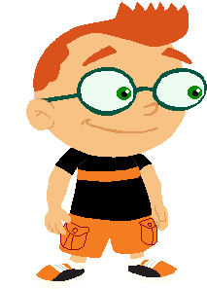
Sentence Relay
Blue Wins !
Red Wins !
Little Einsteins sentence relay stats
Little Einsteins sentence relay stats
Red Team |
Avg speed (m/s)
0.10
Blue Team |
Avg speed (m/s)
0.10
World records
World records

Slide 5
Round 1
Word 1
Word 4
Word 2
Word 3
Word 5
Answer Here

Slide 6
Round 2
Word 1
Word 4
Word 2
Word 3
Word 5
Answer Here

Slide 7
Round 3
Word 1
Word 4
Word 2
Word 3
Word 5
Answer Here

Slide 8
Round 4
Word 1
Word 4
Word 2
Word 3
Word 5
Answer Here

Slide 9
Round 5
Word 1
Word 4
Word 2
Word 3
Word 5
Answer Here

Slide 10
Round 6
Word 1
Word 4
Word 2
Word 3
Word 5
Answer Here

Slide 11
Round 7
Word 1
Word 4
Word 2
Word 3
Word 5
Answer Here

Slide 12
Round 8
Word 1
Word 4
Word 2
Word 3
Word 5
Answer Here

Slide 13
Round 9
Word 1
Word 4
Word 2
Word 3
Word 5
Answer Here

Slide 14
Round 10
Word 1
Word 4
Word 2
Word 3
Word 5
Answer Here

