Slide 1
Fruits

Slide 2
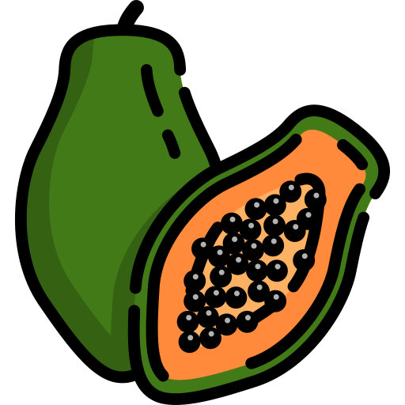
orange
papaya
peach
pear

Slide 3
kiwi
mango
pineapple
grapes

Slide 4
lemon
strawberry
watermelon
cherry

Slide 5
apple
banana
dragon fruit
durian

Slide 6
blueberry
raspberry
guava
passion fruit

