Slide 2
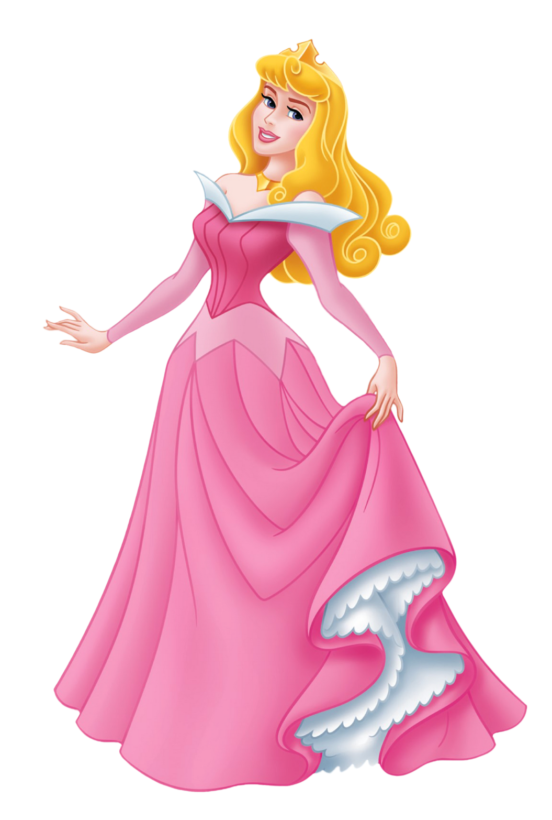
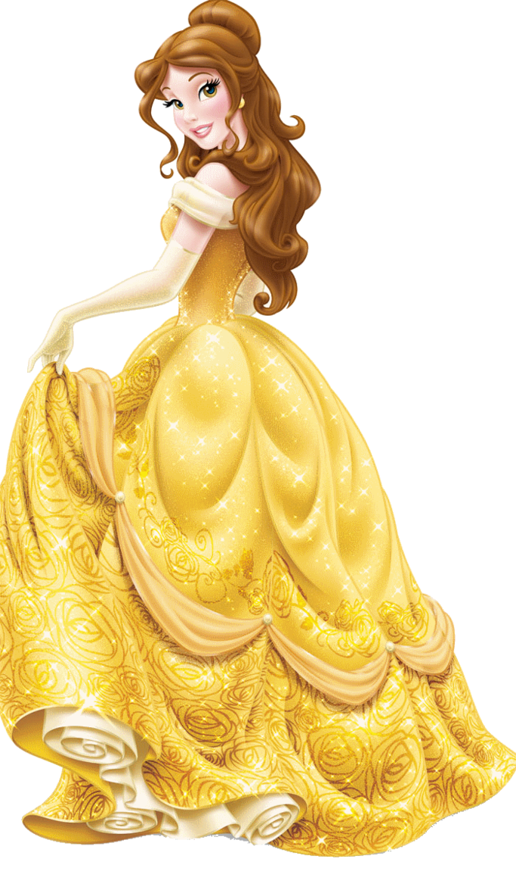
Aa
Bb
Aurora
Belle
www.ladybugclassroom.com
www.ladybugclassroom.com

Slide 3
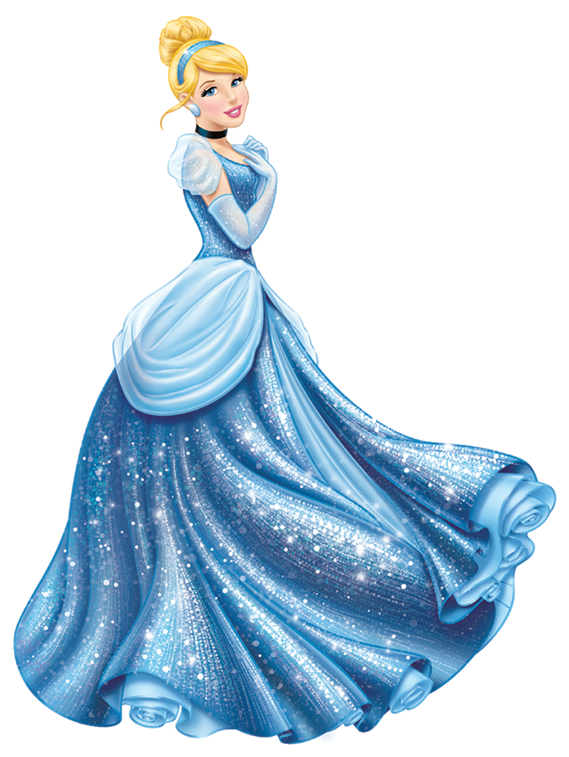
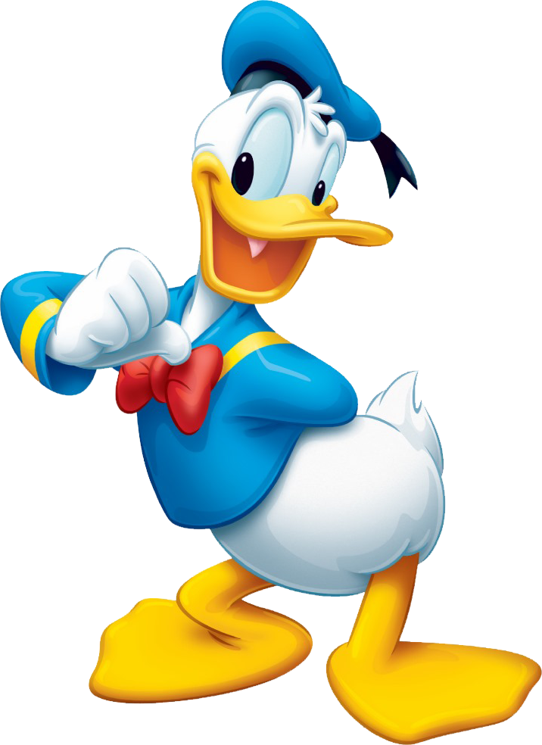
Cc
www.ladybugclassroom.com
Dd
Cinderella
Donald Duck
www.ladybugclassroom.com

Slide 4
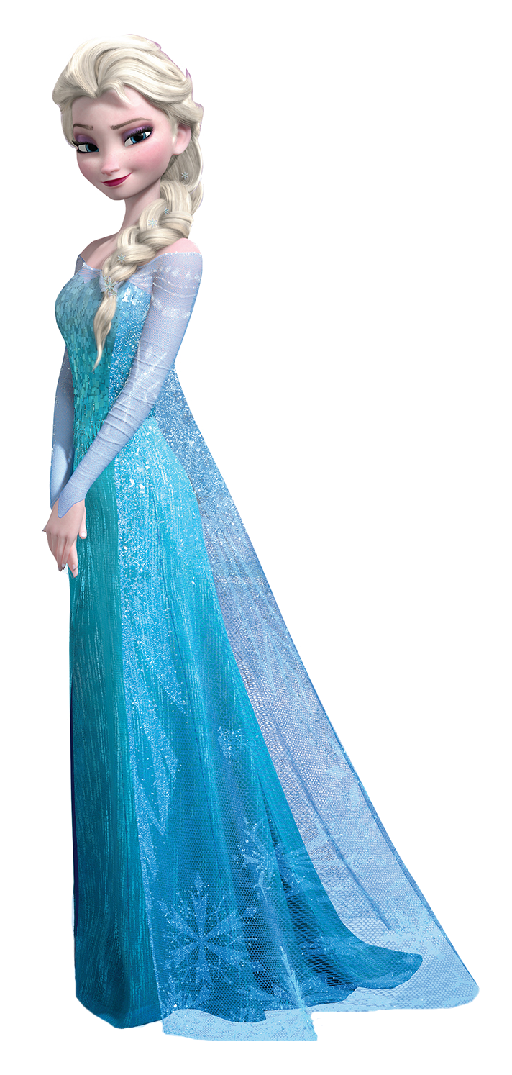
Ee
Ff
Elsa
Flounder
www.ladybugclassroom.com
www.ladybugclassroom.com

Slide 5
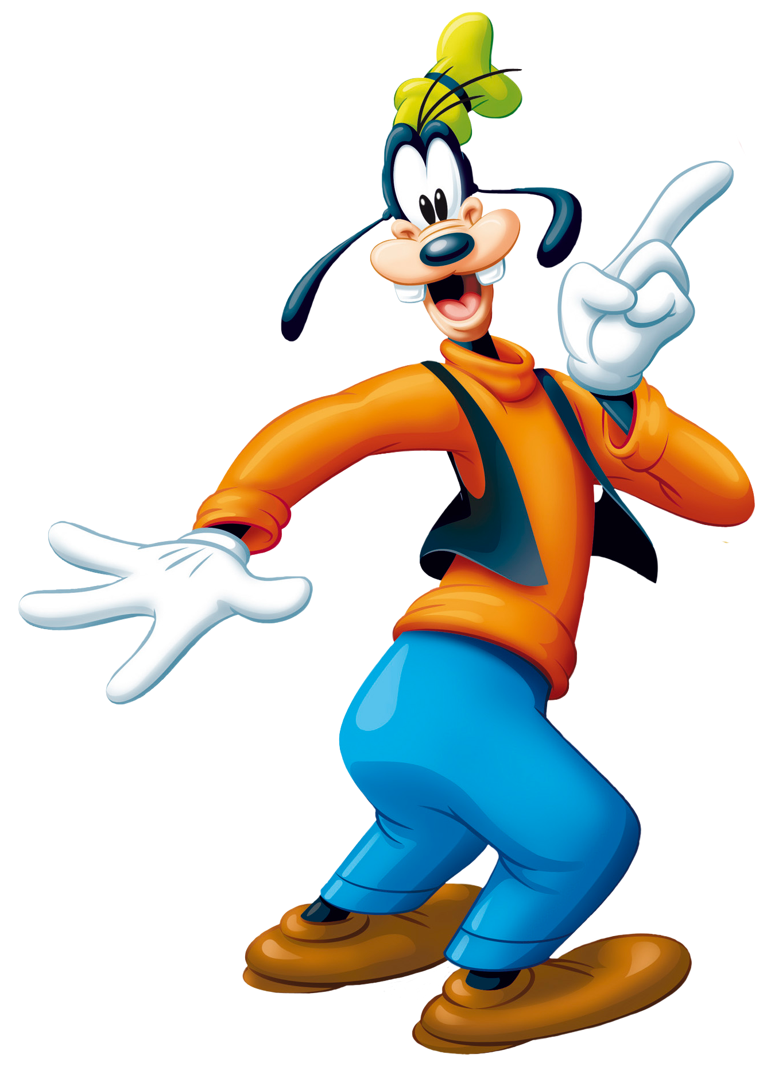
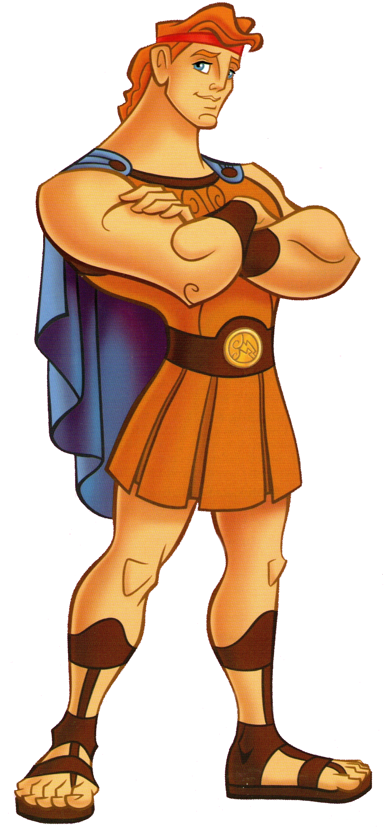
Gg
Hh
Goofy
Hercules
www.ladybugclassroom.com
www.ladybugclassroom.com

Slide 6
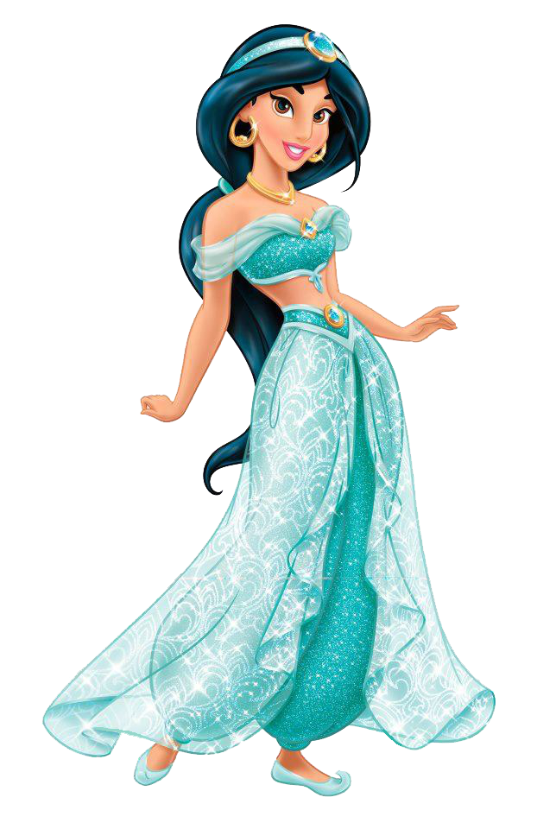
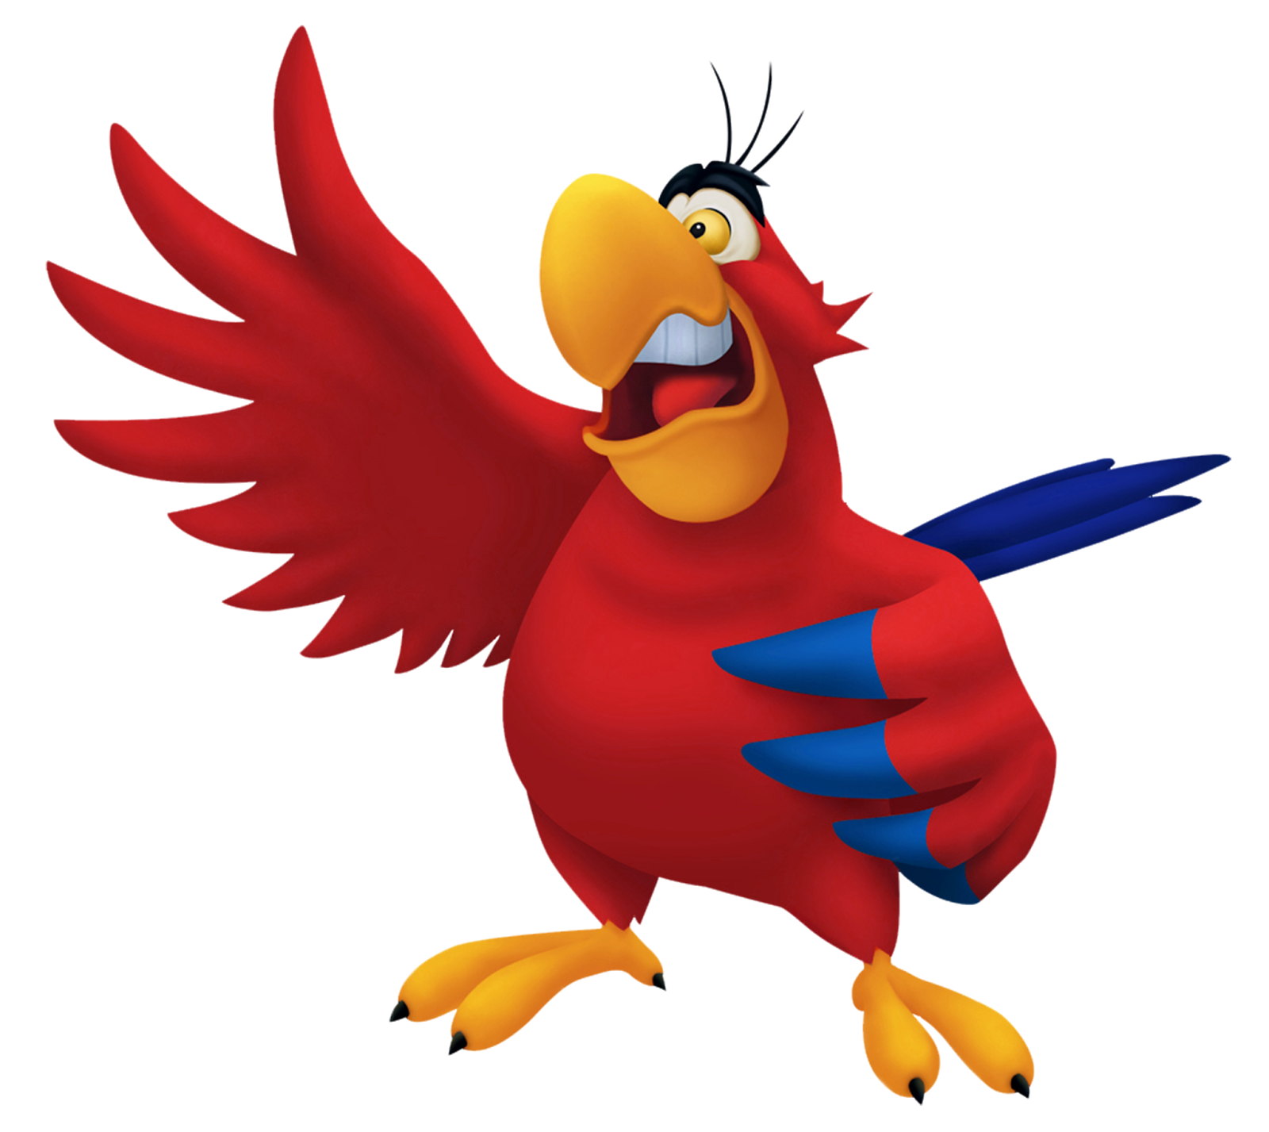
Ii
Jj
Iago
Jasmine
www.ladybugclassroom.com
www.ladybugclassroom.com

Slide 7
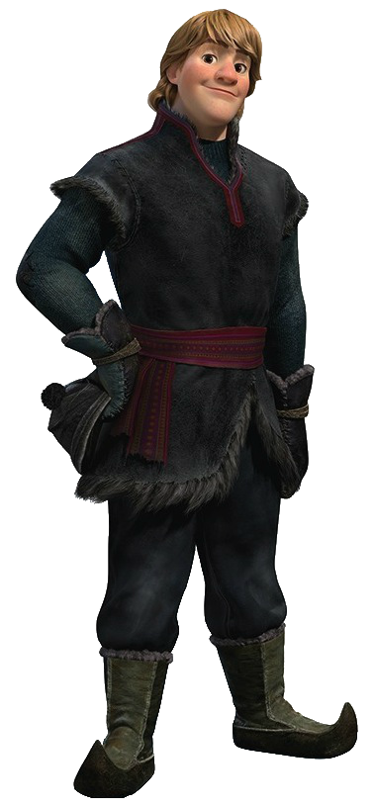
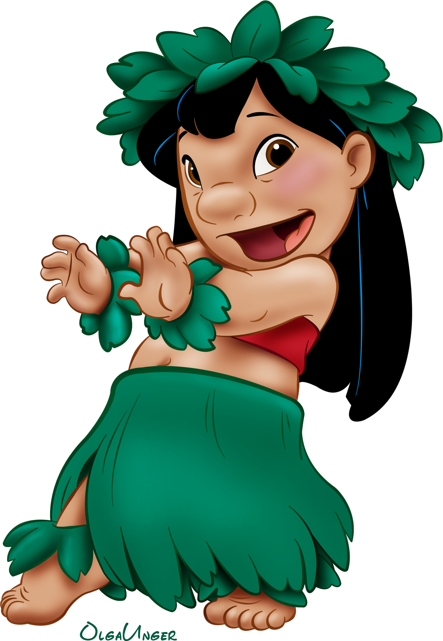
Kk
Ll
Kristoff
Lilo
www.ladybugclassroom.com
www.ladybugclassroom.com

Slide 8
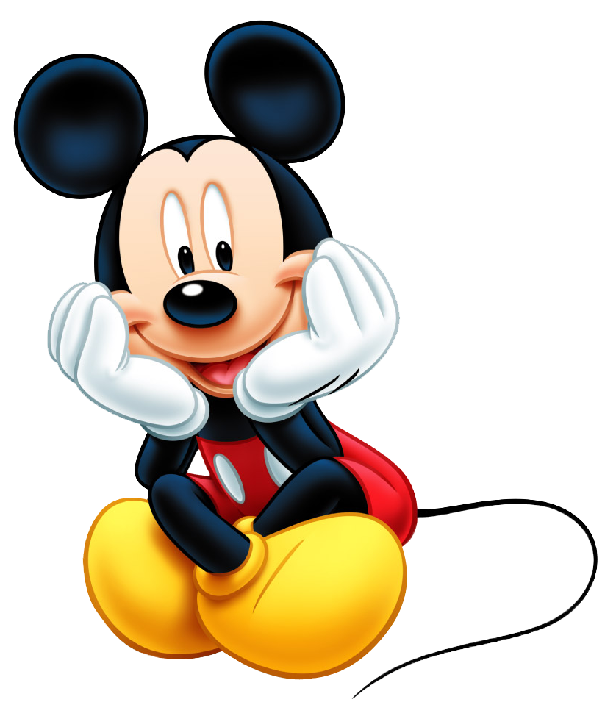
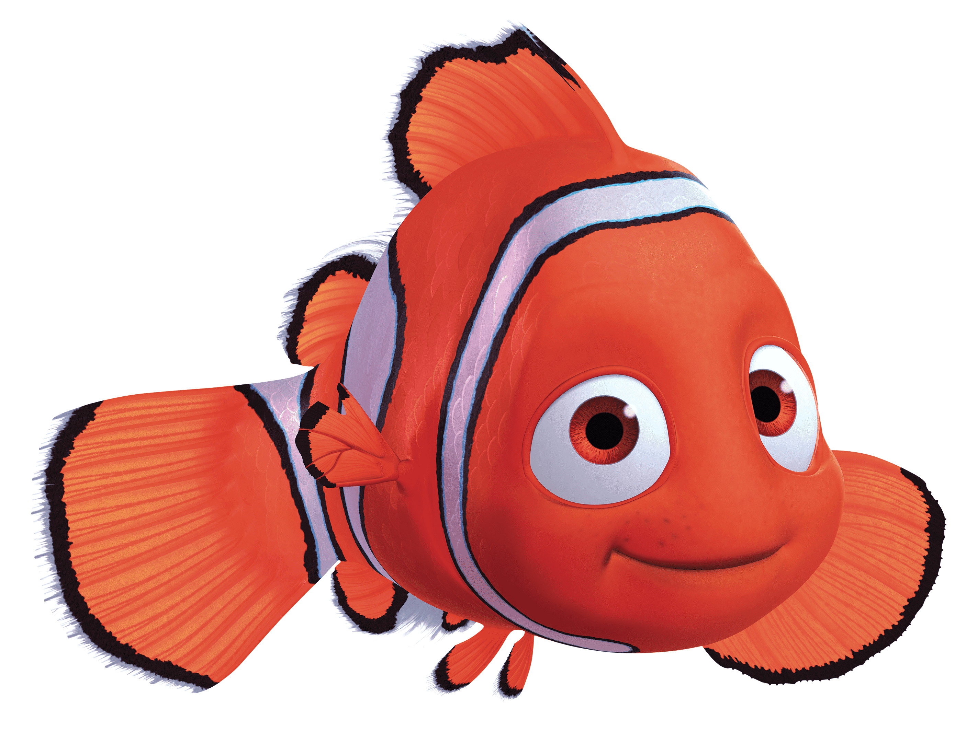
Mm
Nn
Mickey Mouse
Nemo
www.ladybugclassroom.com
www.ladybugclassroom.com

Slide 9
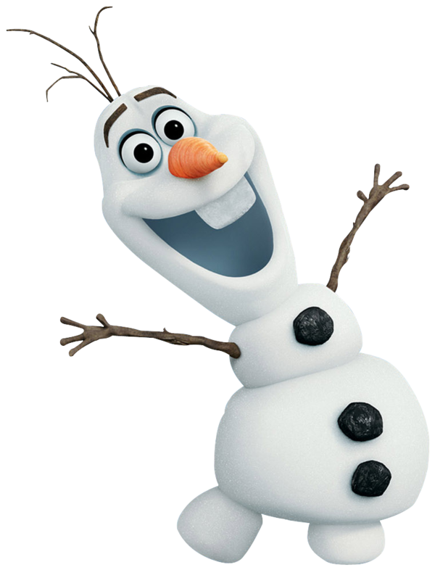
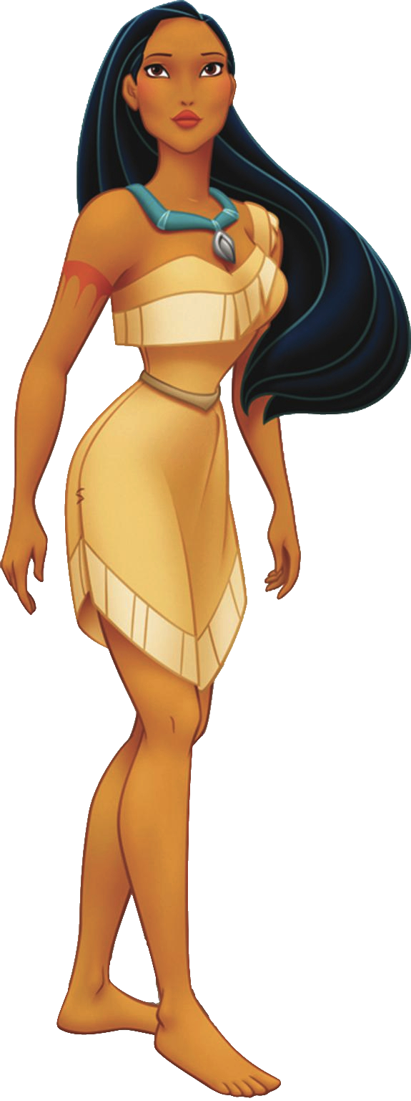
Oo
Pp
www.ladybugclassroom.com
Olaf
Pocahontas
www.ladybugclassroom.com

Slide 10
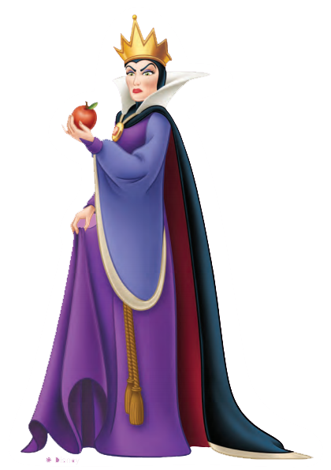
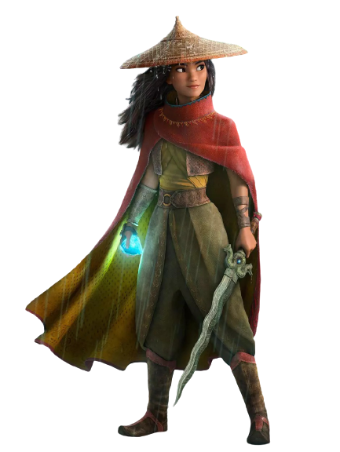
Qq
Rr
Queen
Raya
www.ladybugclassroom.com
www.ladybugclassroom.com

Slide 11
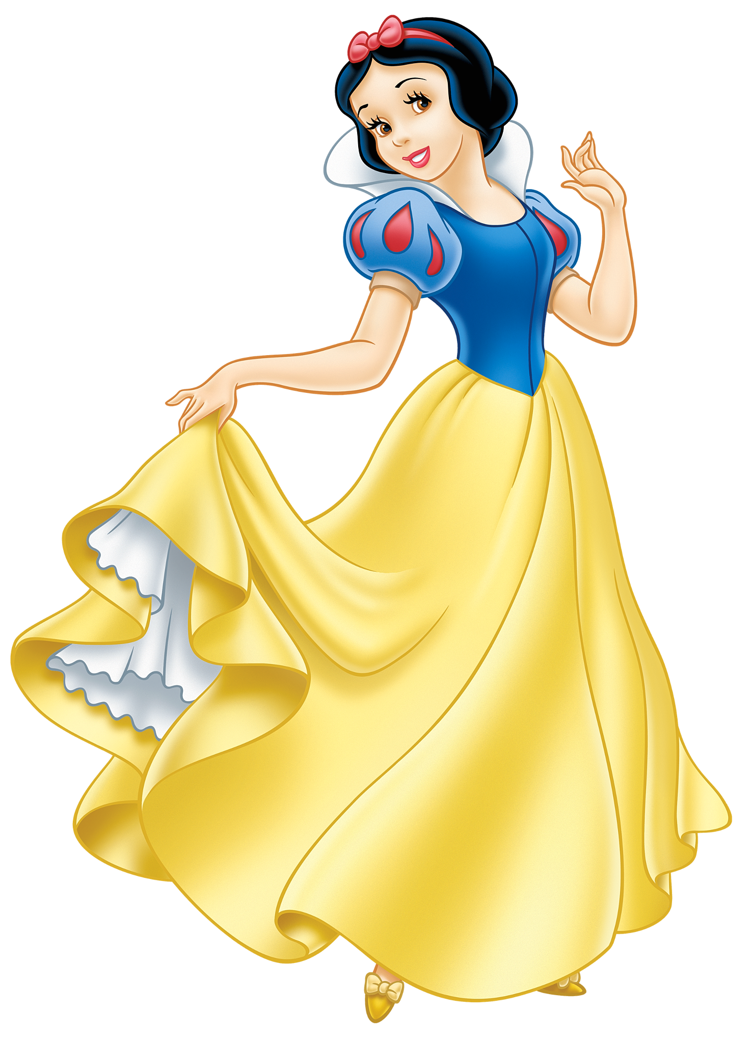
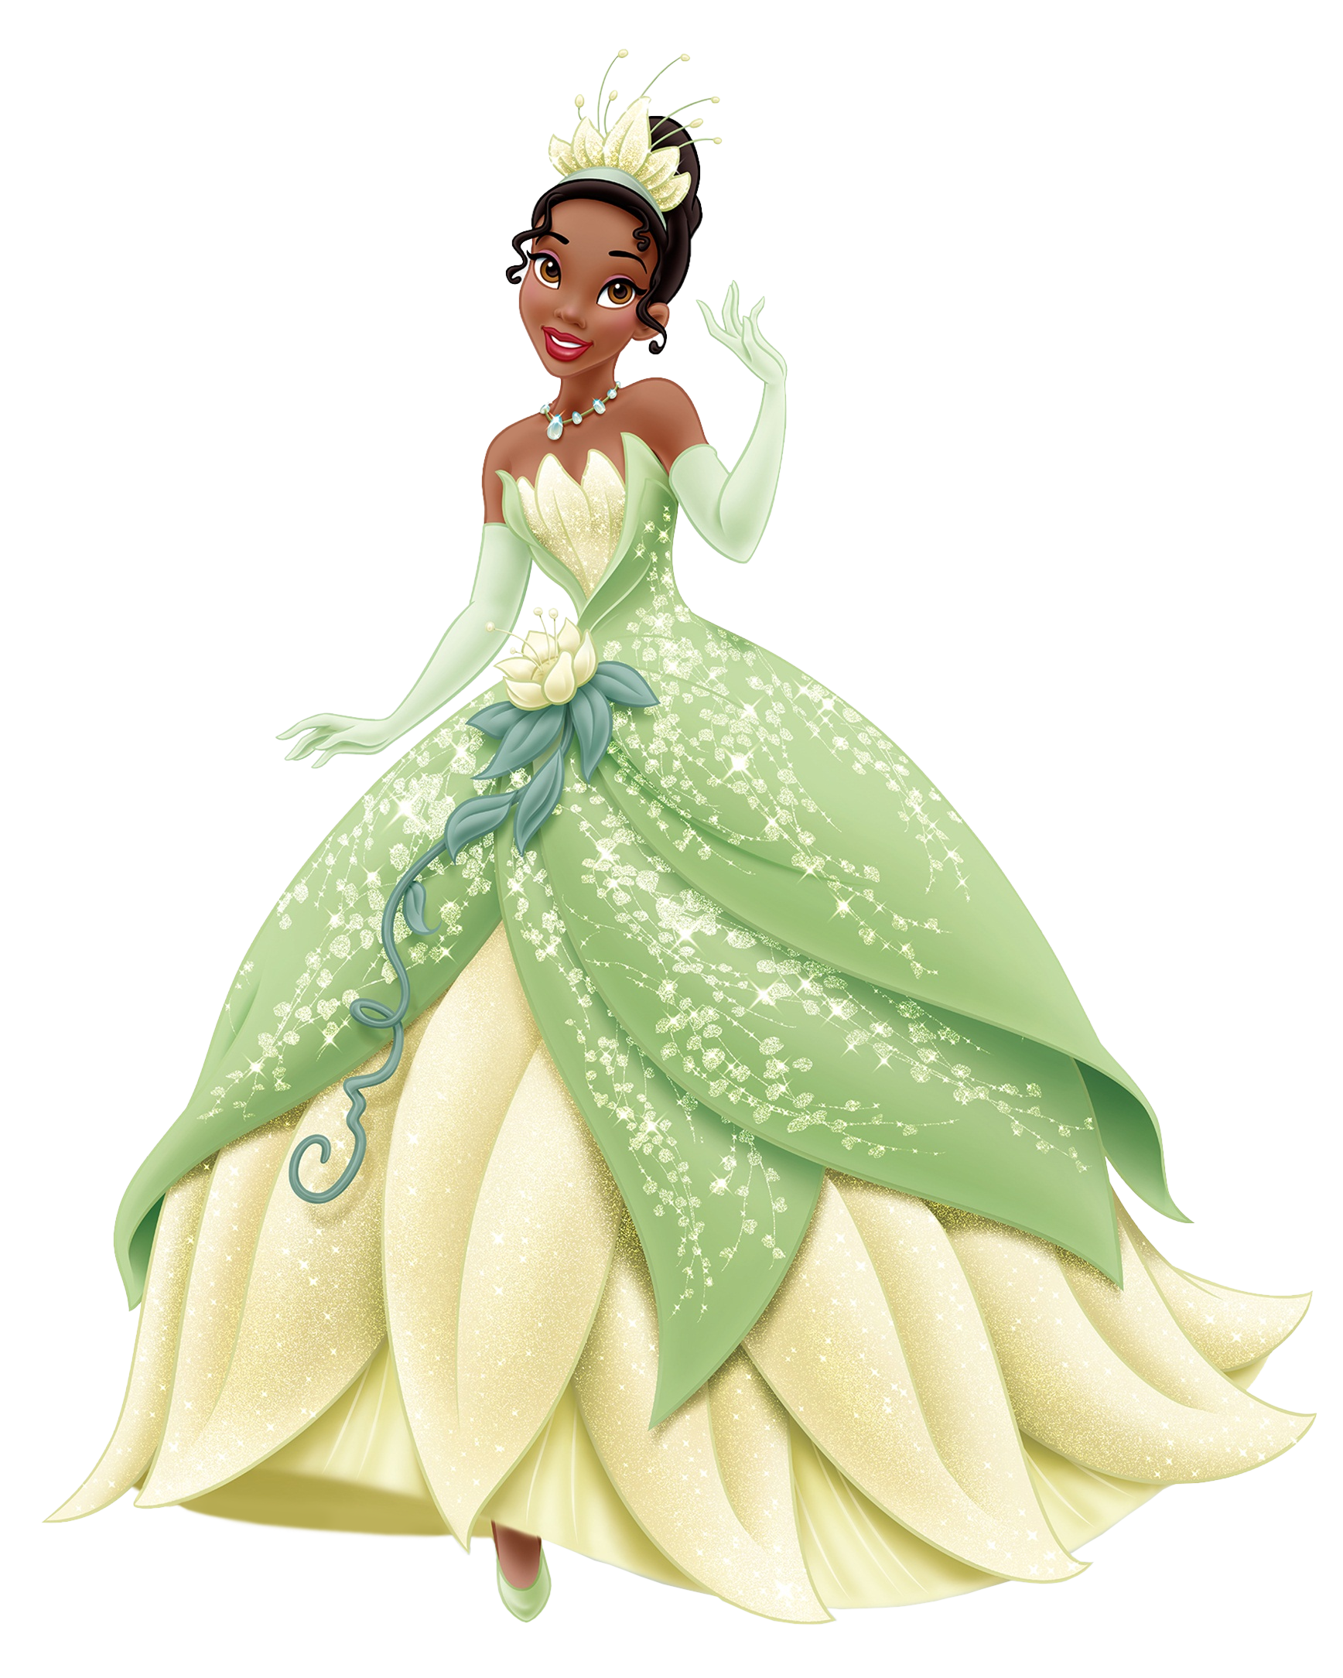
Ss
www.ladybugclassroom.com
Tt
Snow White
Tiana
www.ladybugclassroom.com

Slide 12
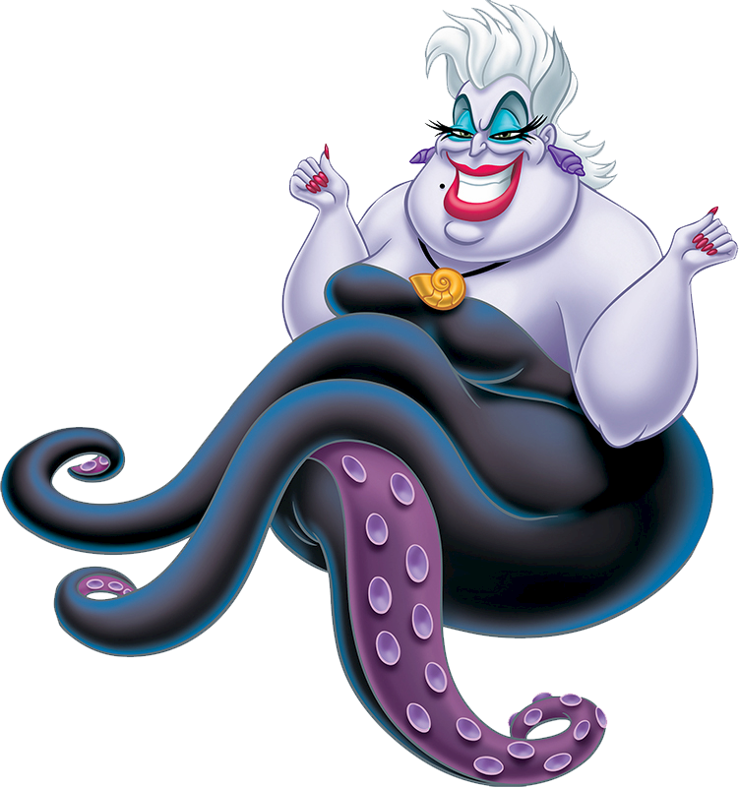
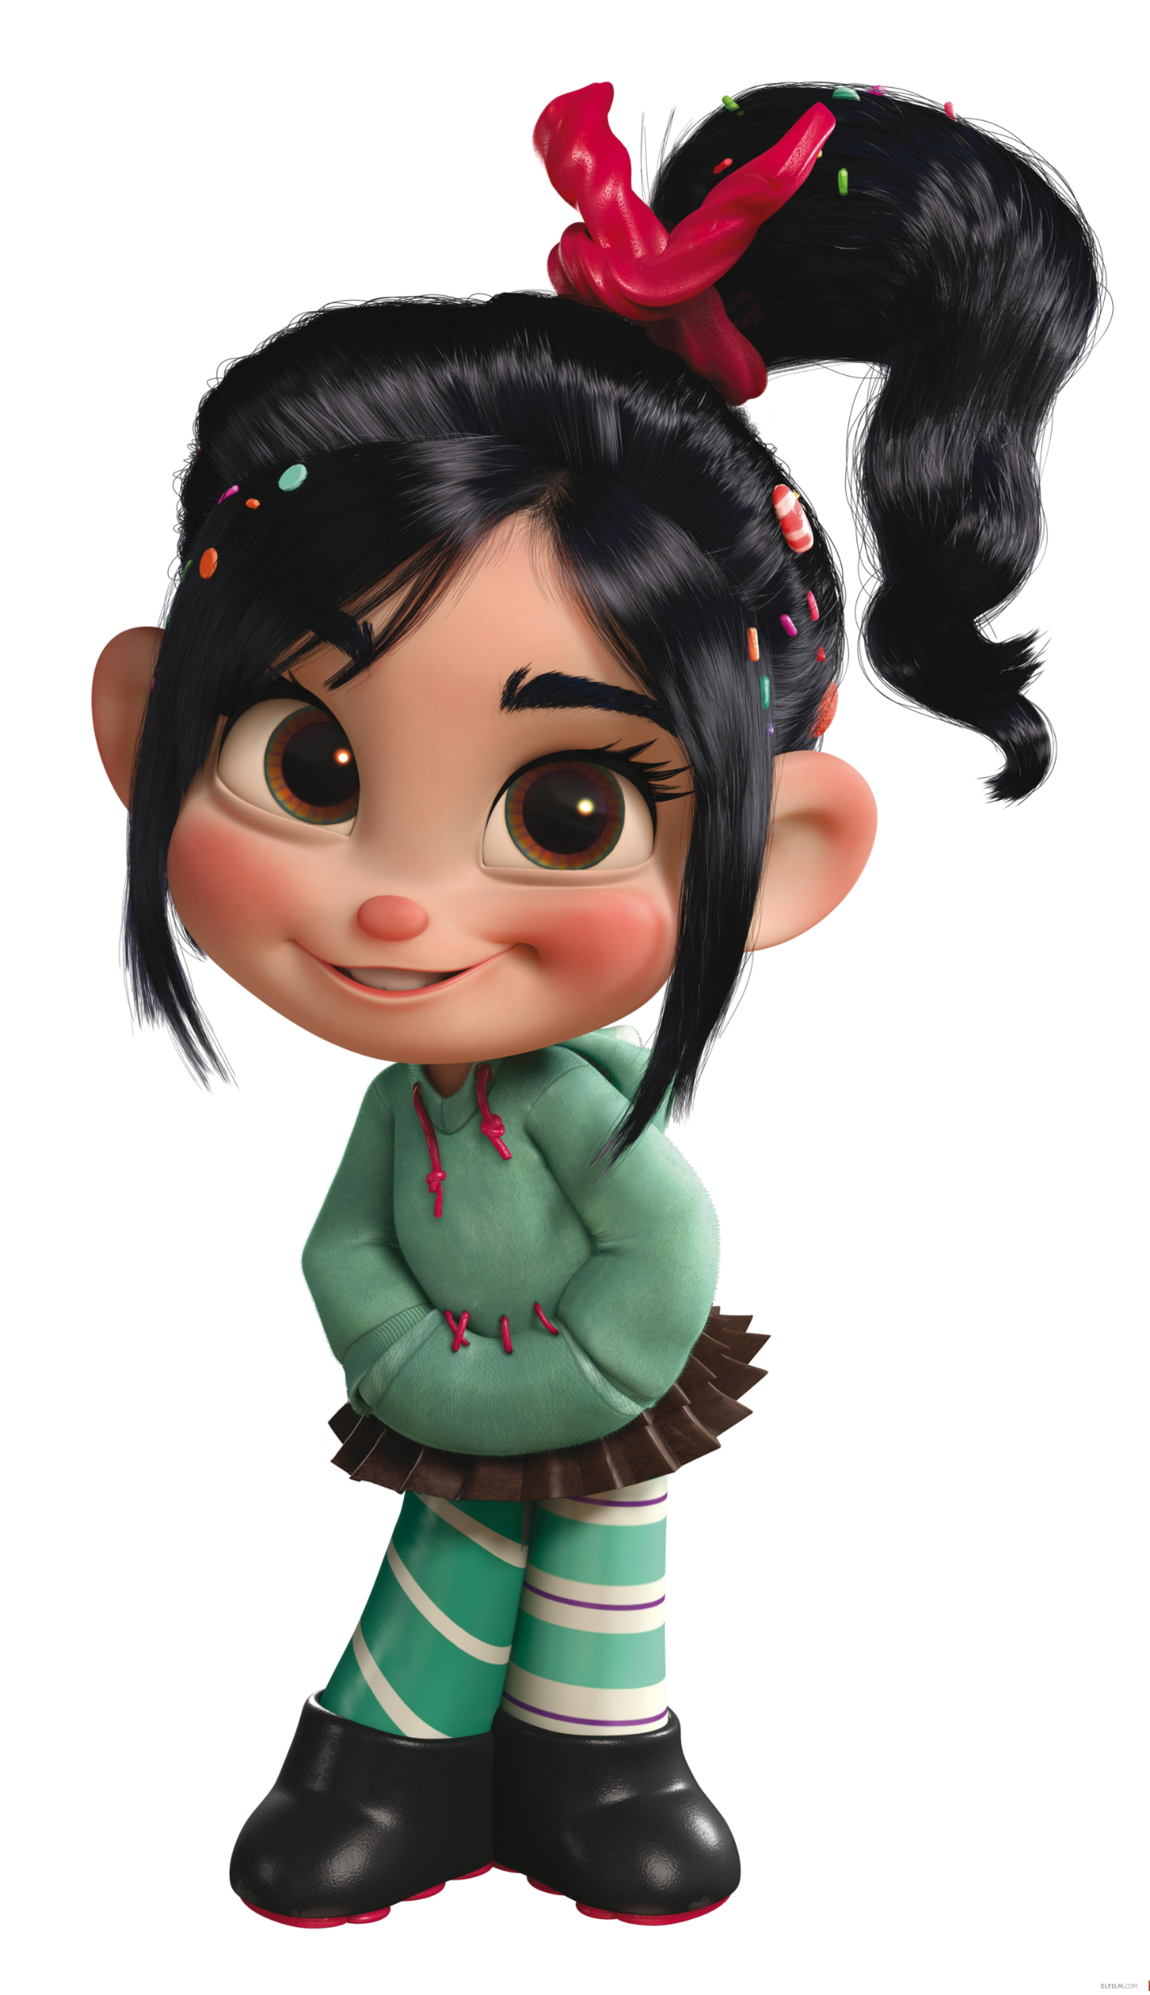
Uu
Vv
www.ladybugclassroom.com
Ursula
Vanellope
www.ladybugclassroom.com

Slide 13
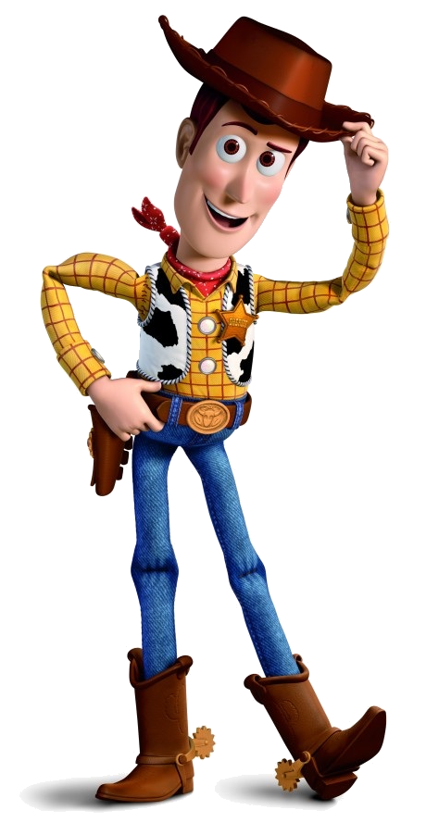
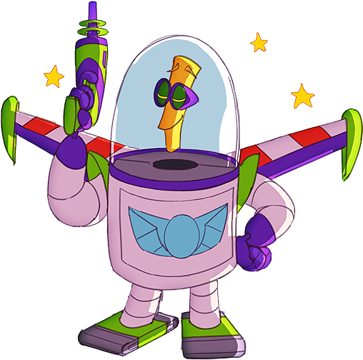
Ww
Xx
Woody
XR
www.ladybugclassroom.com
www.ladybugclassroom.com

Slide 14
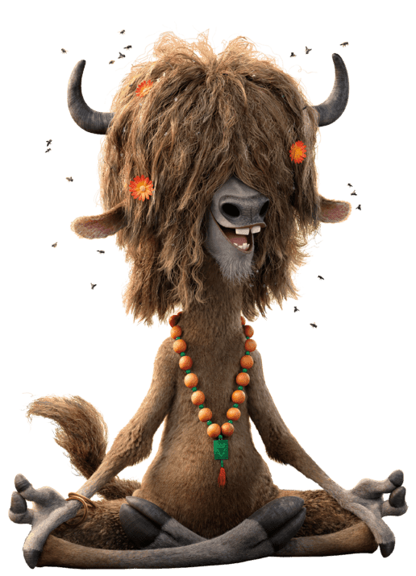
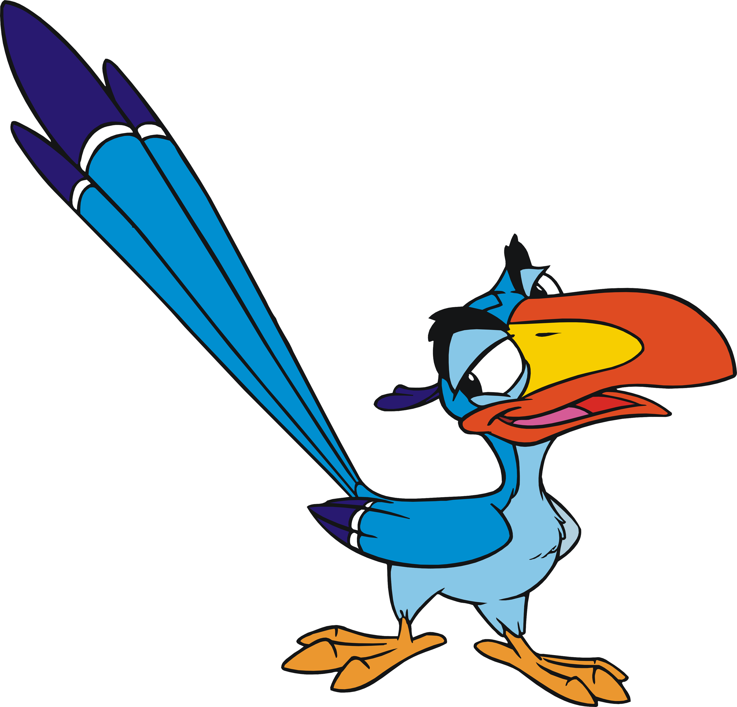
Yy
Zz
Yax
Zazu
www.ladybugclassroom.com

