Slide 1
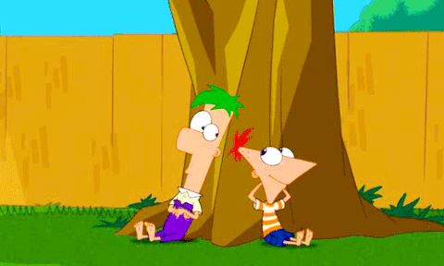
Backyard
Charades
Game template by Kamohelo T. Semela

Slide 2
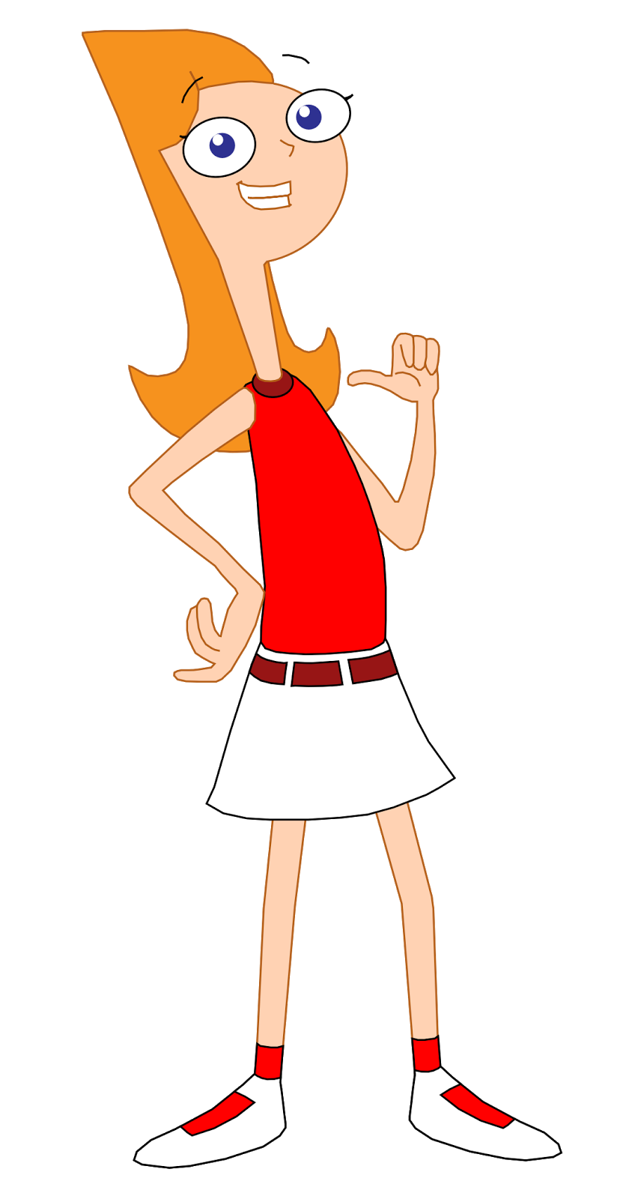
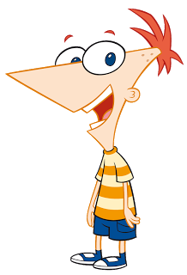
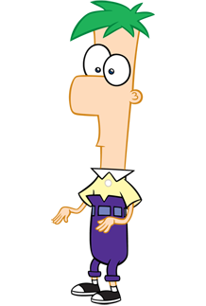
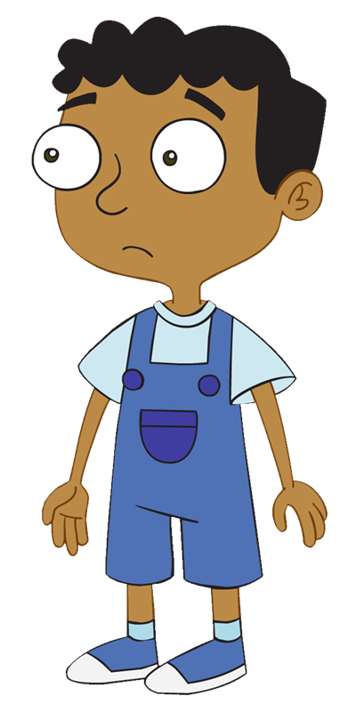
how to play

Slide 3
how to play
Make two teams

Slide 4
how to play
?
Cat !
?
+ 2
Ready ?
The first person to guess correctly earns 2 points for their team.
One person from each team stands in front facing away from the tv.
The person in front tries to guess.
A picture will appear.
Each team acts out what they see on the screen.

Slide 5
3
1
2

Slide 6
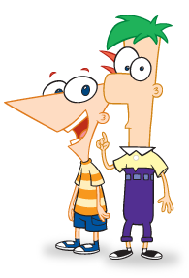
Word here
Notes:
To avoid disrupting the animation, right click the white space and select “replace picture” to add your own pictures. Then adjust the pictures to fit the screen if necessary.

Slide 7
3
1
2

Slide 8
Word here
Notes:
To avoid disrupting the animation, right click the white space and select “replace picture” to add your own pictures. Then adjust the pictures to fit the screen if necessary.

Slide 9
3
1
2

Slide 10
Word here
Notes:
To avoid disrupting the animation, right click the white space and select “replace picture” to add your own pictures. Then adjust the pictures to fit the screen if necessary.

Slide 11
3
1
2

Slide 12
Word here
Notes:
To avoid disrupting the animation, right click the white space and select “replace picture” to add your own pictures. Then adjust the pictures to fit the screen if necessary.

Slide 13
3
1
2

Slide 14
Word here
Notes:
To avoid disrupting the animation, right click the white space and select “replace picture” to add your own pictures. Then adjust the pictures to fit the screen if necessary.

Slide 15
3
1
2

Slide 16
Word here
Notes:
To avoid disrupting the animation, right click the white space and select “replace picture” to add your own pictures. Then adjust the pictures to fit the screen if necessary.

Slide 17
3
1
2

Slide 18
Word here
Notes:
To avoid disrupting the animation, right click the white space and select “replace picture” to add your own pictures. Then adjust the pictures to fit the screen if necessary.

Slide 19
3
1
2

Slide 20
Word here
Notes:
To avoid disrupting the animation, right click the white space and select “replace picture” to add your own pictures. Then adjust the pictures to fit the screen if necessary.

Slide 21
3
1
2

Slide 22
Word here
Notes:
To avoid disrupting the animation, right click the white space and select “replace picture” to add your own pictures. Then adjust the pictures to fit the screen if necessary.

Slide 23
3
1
2

Slide 24
Word here
Notes:
To avoid disrupting the animation, right click the white space and select “replace picture” to add your own pictures. Then adjust the pictures to fit the screen if necessary.

Slide 25
3
1
2

Slide 26
Word here
Notes:
To avoid disrupting the animation, right click the white space and select “replace picture” to add your own pictures. Then adjust the pictures to fit the screen if necessary.

Slide 27
3
1
2

Slide 28
Word here
Notes:
To avoid disrupting the animation, right click the white space and select “replace picture” to add your own pictures. Then adjust the pictures to fit the screen if necessary.

Slide 29
3
1
2

Slide 30
Word here
Notes:
To avoid disrupting the animation, right click the white space and select “replace picture” to add your own pictures. Then adjust the pictures to fit the screen if necessary.

Slide 31
3
1
2

Slide 32
Word here
Notes:
To avoid disrupting the animation, right click the white space and select “replace picture” to add your own pictures. Then adjust the pictures to fit the screen if necessary.

Slide 33
3
1
2

Slide 34
Word here
Notes:
To avoid disrupting the animation, right click the white space and select “replace picture” to add your own pictures. Then adjust the pictures to fit the screen if necessary.

Slide 35
3
1
2

Slide 36
Word here
Notes:
To avoid disrupting the animation, right click the white space and select “replace picture” to add your own pictures. Then adjust the pictures to fit the screen if necessary.

Slide 37
game
over
Notes:
To avoid disrupting the animation, right click the white space and select “replace picture” to add your own pictures. Then adjust the pictures to fit the screen if necessary.

