Slide 1
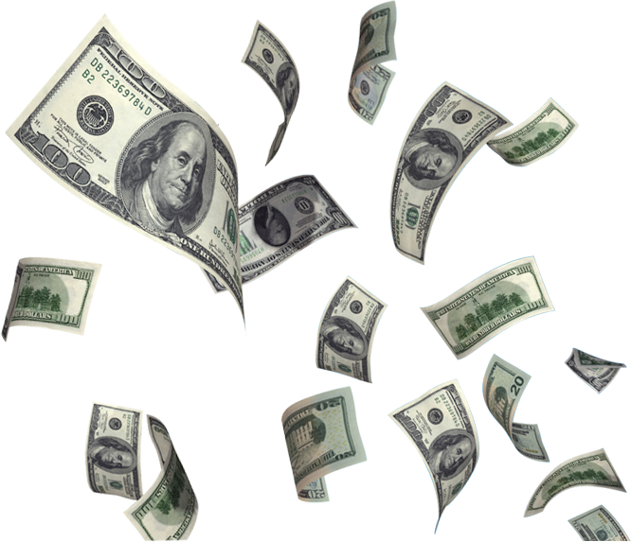
Gotham City
Word Lottery

Slide 2
Instructions
Try your luck at the Gotham City Lottery to win some dollars!

Slide 3
Instructions
Each round choose a sentence to read from the “scratch cards”
The teacher will then “scratch” it for you to reveal your “winnings” or “losses”

Slide 4
Winnings
Losses
1 $$dollar
minus 3 Dollars
Lose all your MOney
3 Dollars
10 Dollars
Blank card means no Money

Slide 5
Round 1

Slide 6
Text here
Text here
Text here
Text here
Text here
Text here
Text here
Text here
Text here
Text here

Slide 7
Text here
Text here
Text here
Text here
Text here
Text here
Text here
Text here
Text here
Text here

Slide 8
Text here
Text here
Text here
Text here
Text here
Text here
Text here
Text here
Text here
Text here

Slide 9
Round 2

Slide 10
Text here
Text here
Text here
Text here
Text here
Text here
Text here
Text here
Text here
Text here

Slide 11
Text here
Text here
Text here
Text here
Text here
Text here
Text here
Text here
Text here
Text here

Slide 12
Text here
Text here
Text here
Text here
Text here
Text here
Text here
Text here
Text here
Text here

Slide 13
Text here
Text here
Text here
Text here
Text here
Text here
Text here
Text here
Text here
Text here

Slide 14
Round 3

Slide 15
Text here
Text here
Text here
Text here
Text here
Text here
Text here
Text here
Text here
Text here

Slide 16
Text here
Text here
Text here
Text here
Text here
Text here
Text here
Text here
Text here
Text here

Slide 17
Text here
Text here
Text here
Text here
Text here
Text here
Text here
Text here
Text here
Text here

Slide 18
Text here
Text here
Text here
Text here
Text here
Text here
Text here
Text here
Text here
Text here

Slide 19
Text here
Text here
Text here
Text here
Text here
Text here
Text here
Text here
Text here
Text here

Slide 20
Game over

