Slide 2
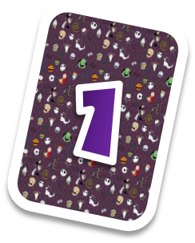
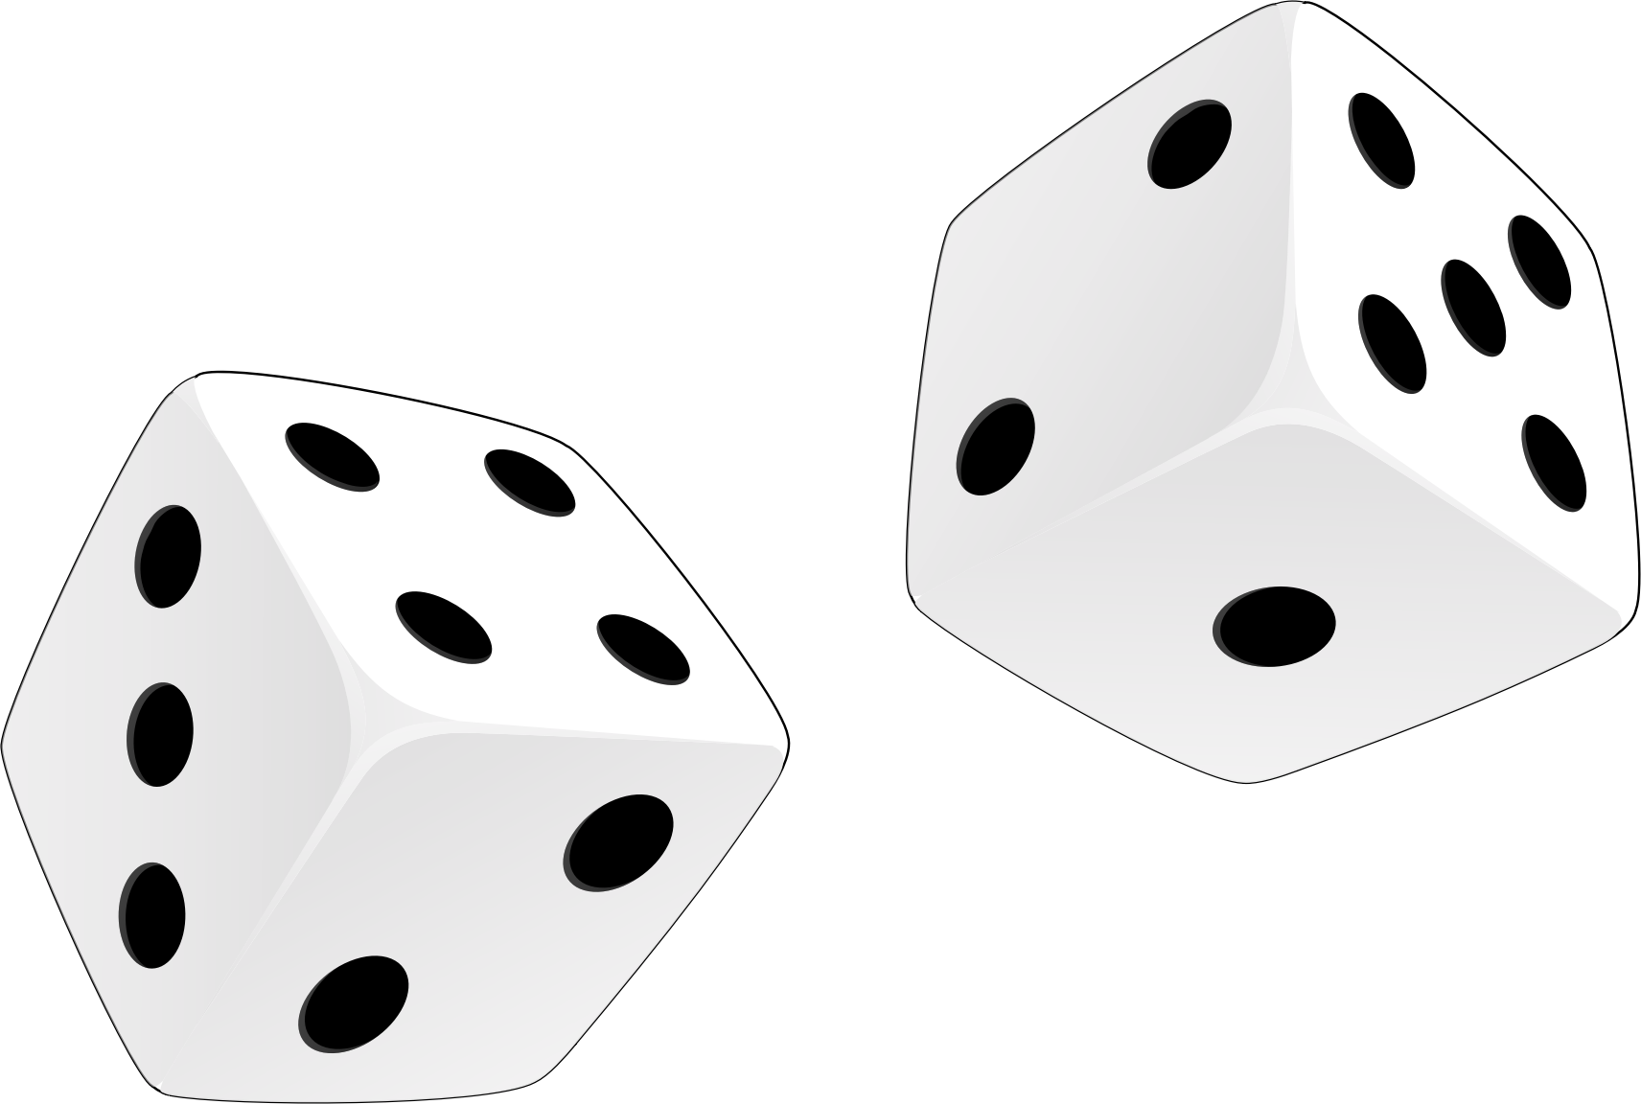
How to play
There are three teams
Each round one team will choose a “card” and answer the question
If the answer is correct, the team gets to roll the dice and play a board game.

Slide 3
How to play
The first team to finish the board game wins!

Slide 4
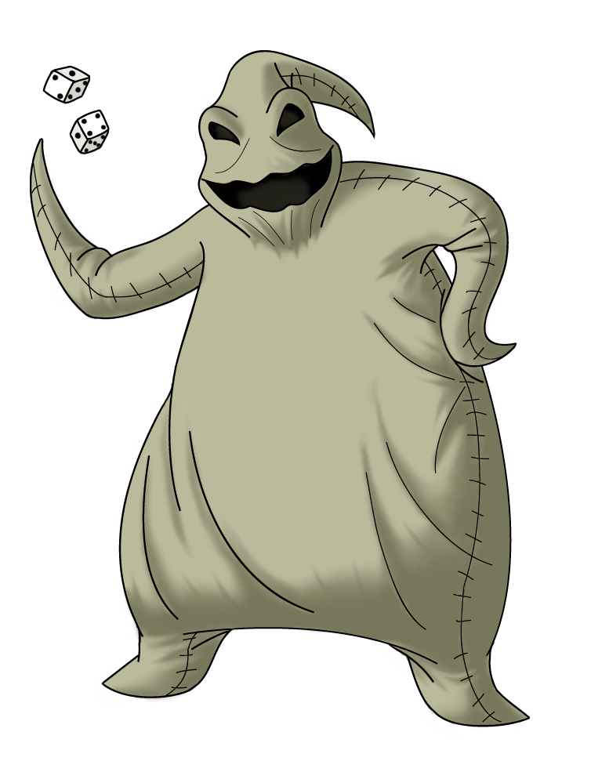
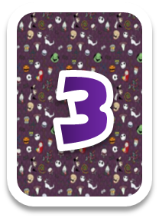
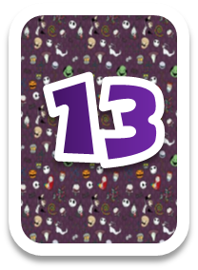
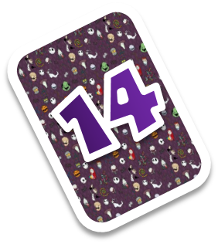
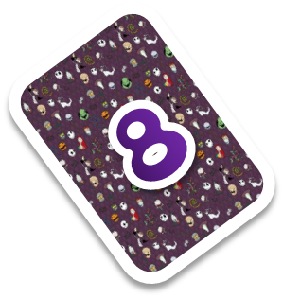
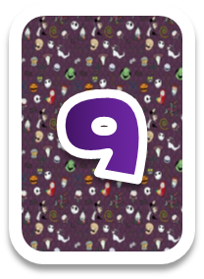
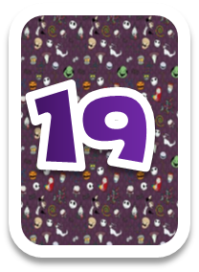
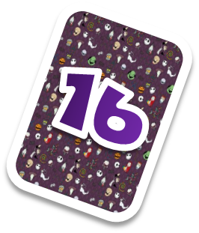
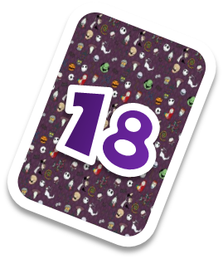
CHOOSE A CARD

Slide 5
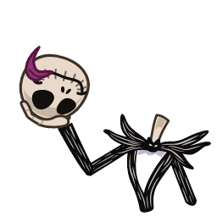
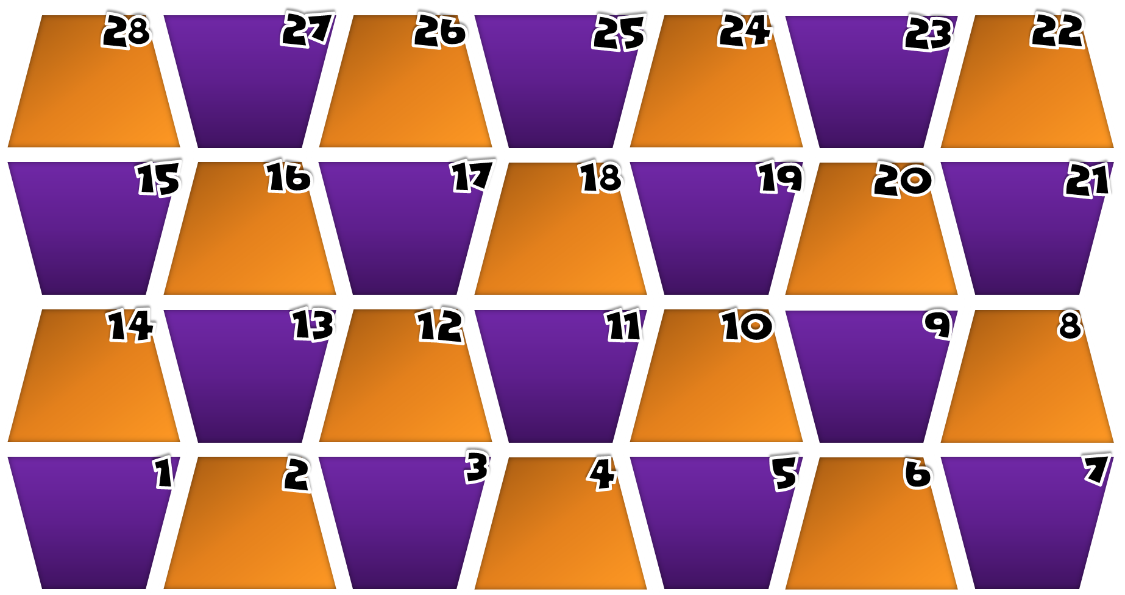
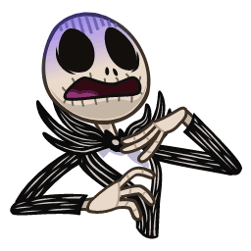
OOGIE BOMB BOARD
Move
back-2
STAY
MOVE
FORWAD+5
FINISH
SWITCH POSITIONS
OOGIE BOMB
(back to start)
ROLL AGAIN
MOVE
FORWAD+5
STAY
STAY
Move forward
+ 4
STAY
STAY
RPS -/+ 3
Move back
-1
Bomb
another team
RPS -/+ 3
Move forward
+1
Move forward
+ 4
Bomb
another team
Move back-2
Move back
-1
ROLL AGAIN
STAY
START
OOGIE BOMB
(back to start)
SWITCH POSITIONS
STAY

Slide 6
Question/Instructions
Additional text / images
Answer here
Notes:
Upside down Jack takes you to the question choosing slide.
Right side up Jack takes you to the board game.
Press the spacebar to reveal the answer.

Slide 7
Question/Instructions
Additional text / images
Answer here
Notes:
Upside down Jack takes you to the question choosing slide.
Right side up Jack takes you to the board game.
Press the spacebar to reveal the answer.

Slide 8
Question/Instructions
Additional text / images
Answer here
Notes:
Upside down Jack takes you to the question choosing slide.
Right side up Jack takes you to the board game.
Press the spacebar to reveal the answer.

Slide 9
Question/Instructions
Additional text / images
Answer here
Notes:
Upside down Jack takes you to the question choosing slide.
Right side up Jack takes you to the board game.
Press the spacebar to reveal the answer.

Slide 10
Question/Instructions
Additional text / images
Answer here
Notes:
Upside down Jack takes you to the question choosing slide.
Right side up Jack takes you to the board game.
Press the spacebar to reveal the answer.

Slide 11
Question/Instructions
Additional text / images
Answer here
Notes:
Upside down Jack takes you to the question choosing slide.
Right side up Jack takes you to the board game.
Press the spacebar to reveal the answer.

Slide 12
Question/Instructions
Additional text / images
Answer here
Notes:
Upside down Jack takes you to the question choosing slide.
Right side up Jack takes you to the board game.
Press the spacebar to reveal the answer.

Slide 13
Question/Instructions
Additional text / images
Answer here
Notes:
Upside down Jack takes you to the question choosing slide.
Right side up Jack takes you to the board game.
Press the spacebar to reveal the answer.

Slide 14
Question/Instructions
Additional text / images
Answer here
Notes:
Upside down Jack takes you to the question choosing slide.
Right side up Jack takes you to the board game.
Press the spacebar to reveal the answer.

Slide 15
Question/Instructions
Additional text / images
Answer here
Notes:
Upside down Jack takes you to the question choosing slide.
Right side up Jack takes you to the board game.
Press the spacebar to reveal the answer.

Slide 16
Question/Instructions
Additional text / images
Answer here
Notes:
Upside down Jack takes you to the question choosing slide.
Right side up Jack takes you to the board game.
Press the spacebar to reveal the answer.

Slide 17
Question/Instructions
Additional text / images
Answer here
Notes:
Upside down Jack takes you to the question choosing slide.
Right side up Jack takes you to the board game.
Press the spacebar to reveal the answer.

Slide 18
Question/Instructions
Additional text / images
Answer here
Notes:
Upside down Jack takes you to the question choosing slide.
Right side up Jack takes you to the board game.
Press the spacebar to reveal the answer.

Slide 19
Question/Instructions
Additional text / images
Answer here
Notes:
Upside down Jack takes you to the question choosing slide.
Right side up Jack takes you to the board game.
Press the spacebar to reveal the answer.

Slide 20
Question/Instructions
Additional text / images
Answer here
Notes:
Upside down Jack takes you to the question choosing slide.
Right side up Jack takes you to the board game.
Press the spacebar to reveal the answer.

Slide 21
Question/Instructions
Additional text / images
Answer here
Notes:
Upside down Jack takes you to the question choosing slide.
Right side up Jack takes you to the board game.
Press the spacebar to reveal the answer.

Slide 22
Question/Instructions
Additional text / images
Answer here
Notes:
Upside down Jack takes you to the question choosing slide.
Right side up Jack takes you to the board game.
Press the spacebar to reveal the answer.

Slide 23
Question/Instructions
Additional text / images
Answer here
Notes:
Upside down Jack takes you to the question choosing slide.
Right side up Jack takes you to the board game.
Press the spacebar to reveal the answer.

Slide 24
Question/Instructions
Additional text / images
Answer here
Notes:
Upside down Jack takes you to the question choosing slide.
Right side up Jack takes you to the board game.
Press the spacebar to reveal the answer.

Slide 25
Question/Instructions
Additional text / images
Answer here
Notes:
Upside down Jack takes you to the question choosing slide.
Right side up Jack takes you to the board game.
Press the spacebar to reveal the answer.

Slide 26
Question/Instructions
Additional text / images
Answer here
Notes:
Upside down Jack takes you to the question choosing slide.
Right side up Jack takes you to the board game.
Press the spacebar to reveal the answer.

Slide 27
https://tenor.com/users/juliahgallego/stickers
Jack Skellinton Stickers:

